Slide 1
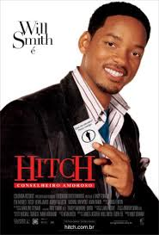
Memorability for Men in Online Dating
Type Right =
Swiped Right

Slide 2
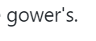
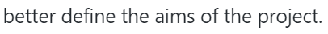
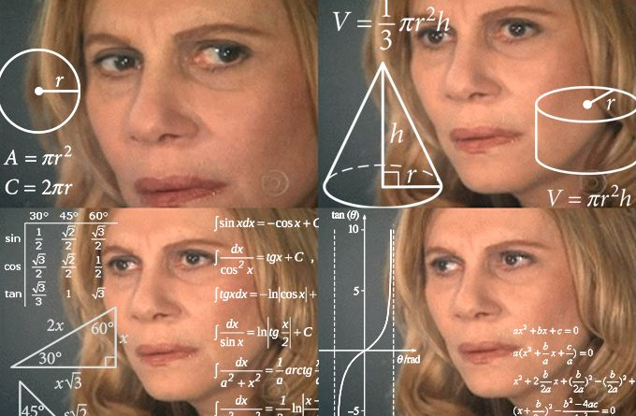
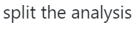
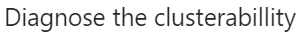
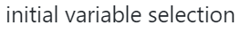
Where We Left Off

Slide 3
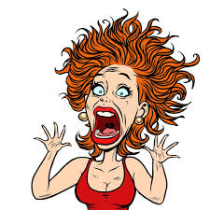
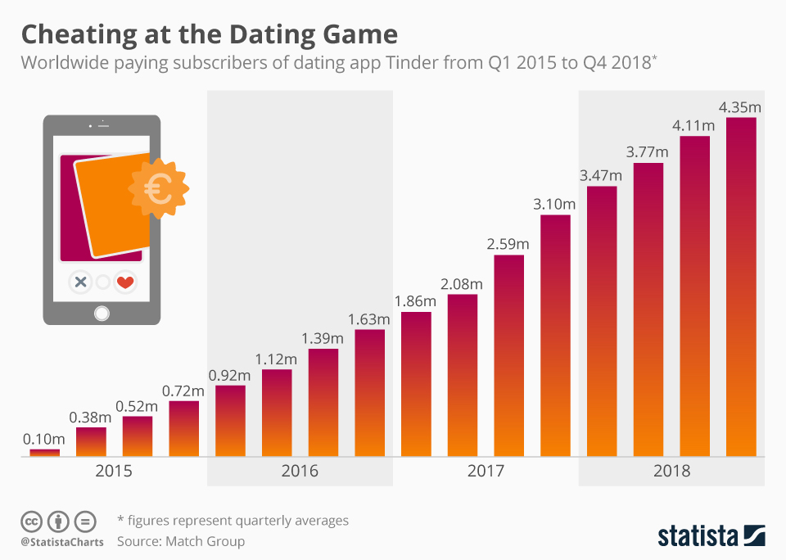
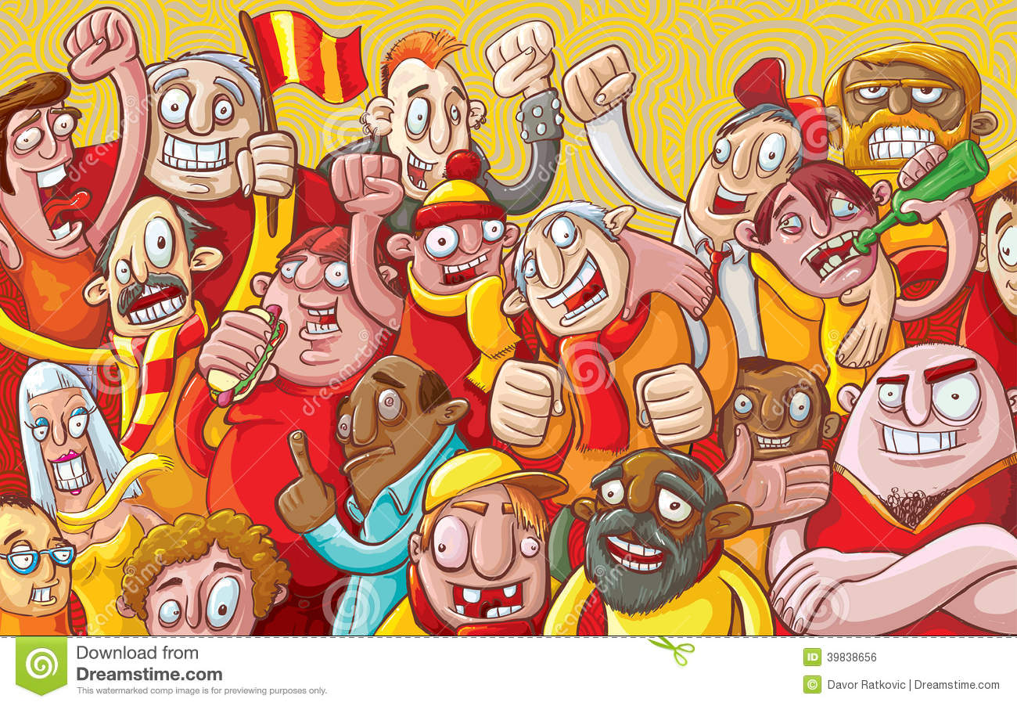
It’s Raining Men
Percentage Male Users:
52.4%
Relevant Research
Emory (2017)
Notes:
Marketplace; too many men; more important for men to write good essays

Slide 4
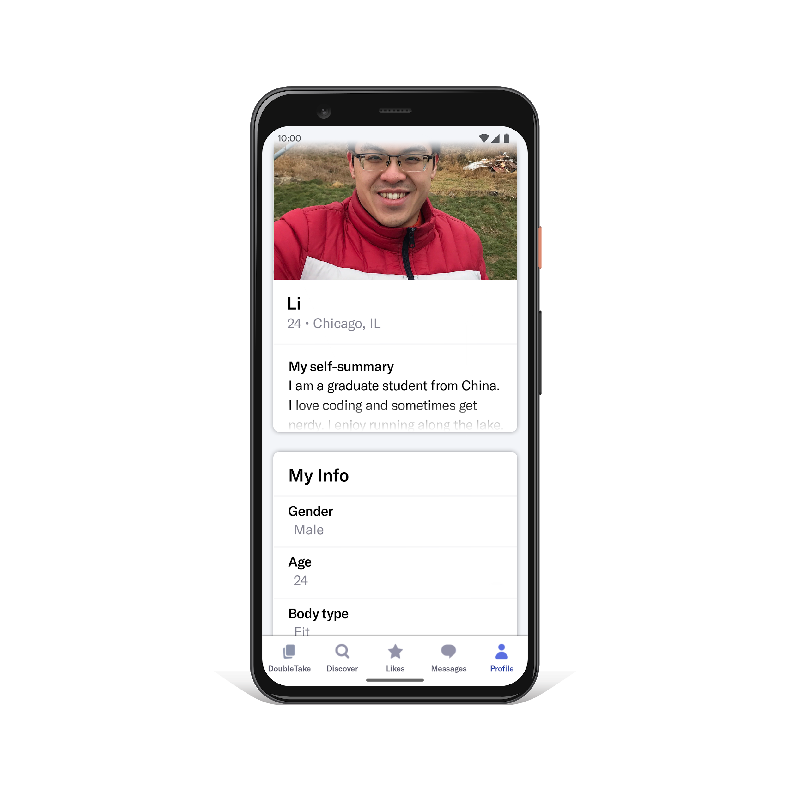
What’s in a profile?
Text data (short essays)
Demographic data
Photos
Chat Windows
Matches
All data is user-submitted
We focus on approximately 18,000 profiles of men in the San Francisco area from 2012
Relevant Research
Emory (2017)
Fiore et al (2010)
Notes:
Why this data
Fiore: important factor is image; but don’t have photos

Slide 5
The 2 Key Questions:
What are other men like me writing in their profiles?
Finding the ‘closest’ competitors- demographics or new metrics
Most Common Topics
Most Common Words
What can I do to make my essay be memorable and stand out?
Diverge from your Demographic or Cluster’s Topic Preferences/ Proportions
Use unusual words
Humour
Focused Topics
Notes:
What are the competitions and what they are doing
“Closest competitros

Slide 6

Official Tip for Beginners by OkCupid:
Be authentic. Don't be afraid to share things about yourself that are quirky, slightly embarrassing, or totally unique to you: they'll make great conversation starters!
Source: https://help.okcupid.com/article/15-your-profile
Notes:
Li: However, this tip has limitations. For example, I might think ‘cooking’ is quite unique to me. But what if most of my peers also like cooking? So this leads to our key questions to explore using UML techniques.

Slide 7
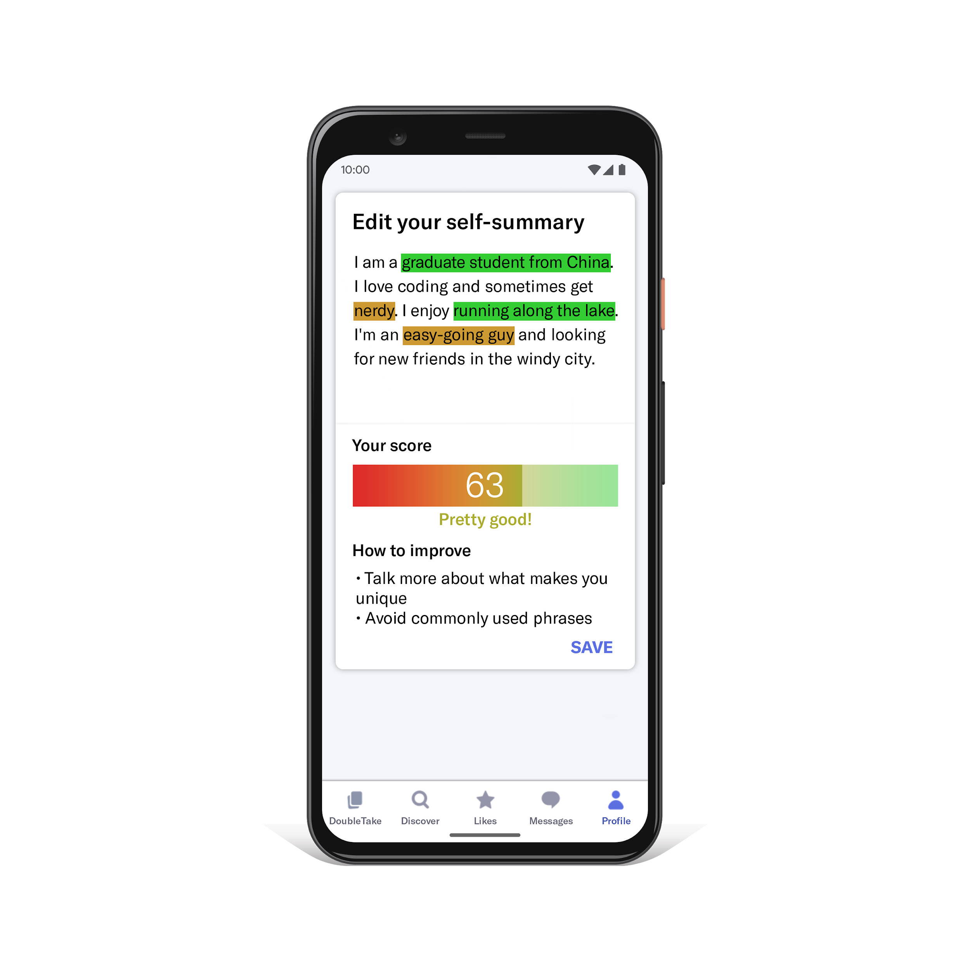
Future Applications
Predict “memorability score” (rescaled to 0-100 from the number of ‘likes’)
Cosine Similarity on Vector Space Models
Topics Network Relationship and Proportions to recommend content for users
Notes:
I ran down the Great Wall of China to make a world record for Nerds. When I’m not saving the world with math, I am busy trying to sell you things you don’t need, but will buy anyway.

Slide 8
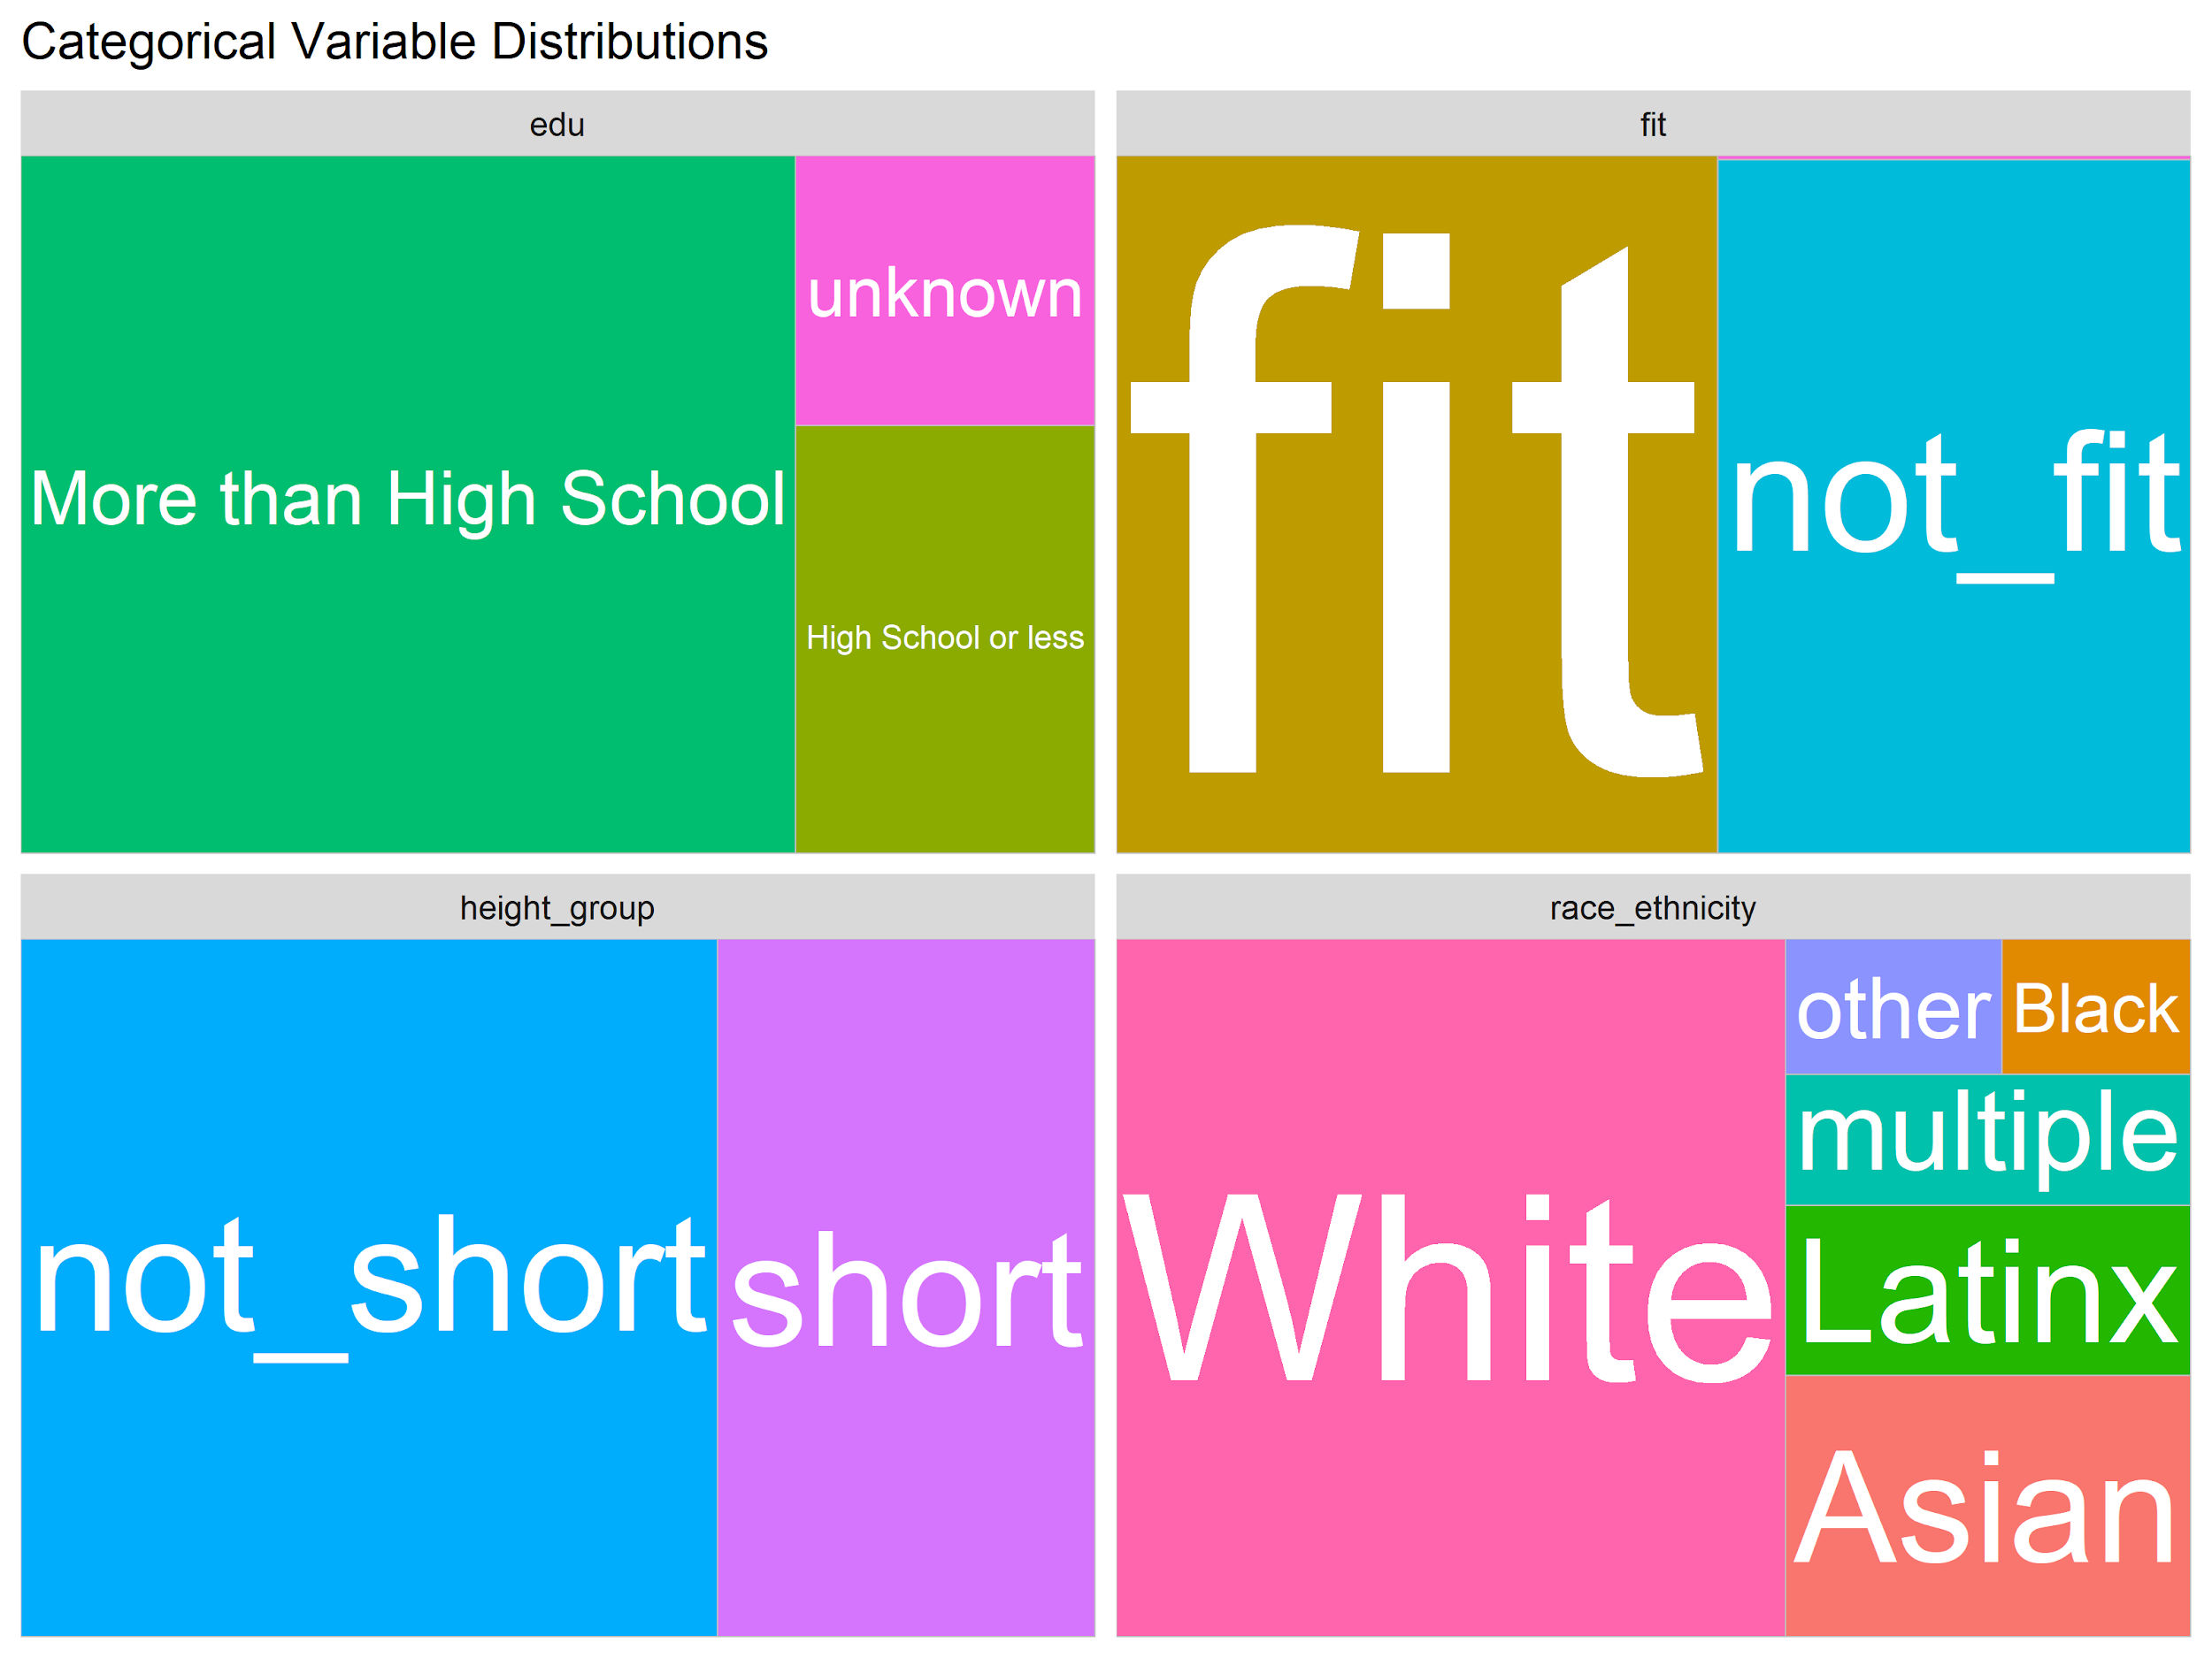
Demographic Variables
References:
Education: (Torkey, 2018), (Fiore et al, 2015), (Stevens & Schaefer, 1990)
Height: Shepperd & Strattman, 1989
Race: Lindqvist and Lin, 2010
Fitness Level: Burke, 2019
Notes:
Shift from a High School Diploma to a Bachelor’s Degree was sufficient to raise median weekly income by about 65% .
The preference for highly educated men as partners has been observed widely , potentially due to correlations with intelligence and earning power

Slide 9
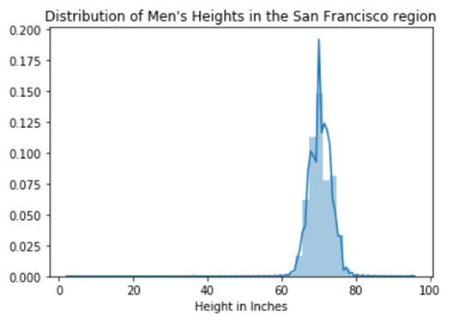
Demographics (Continued)
Stat Height (in inches)
Mean 70.5
Std 3
Min 3
25% 69
50% 70
75% 72
Max 95
Notes:
Men height overstated by two inches
Female users of dating sites cited height as an important element of their preferences for male partners OkCupid (2010)- Overstating of height

Slide 11
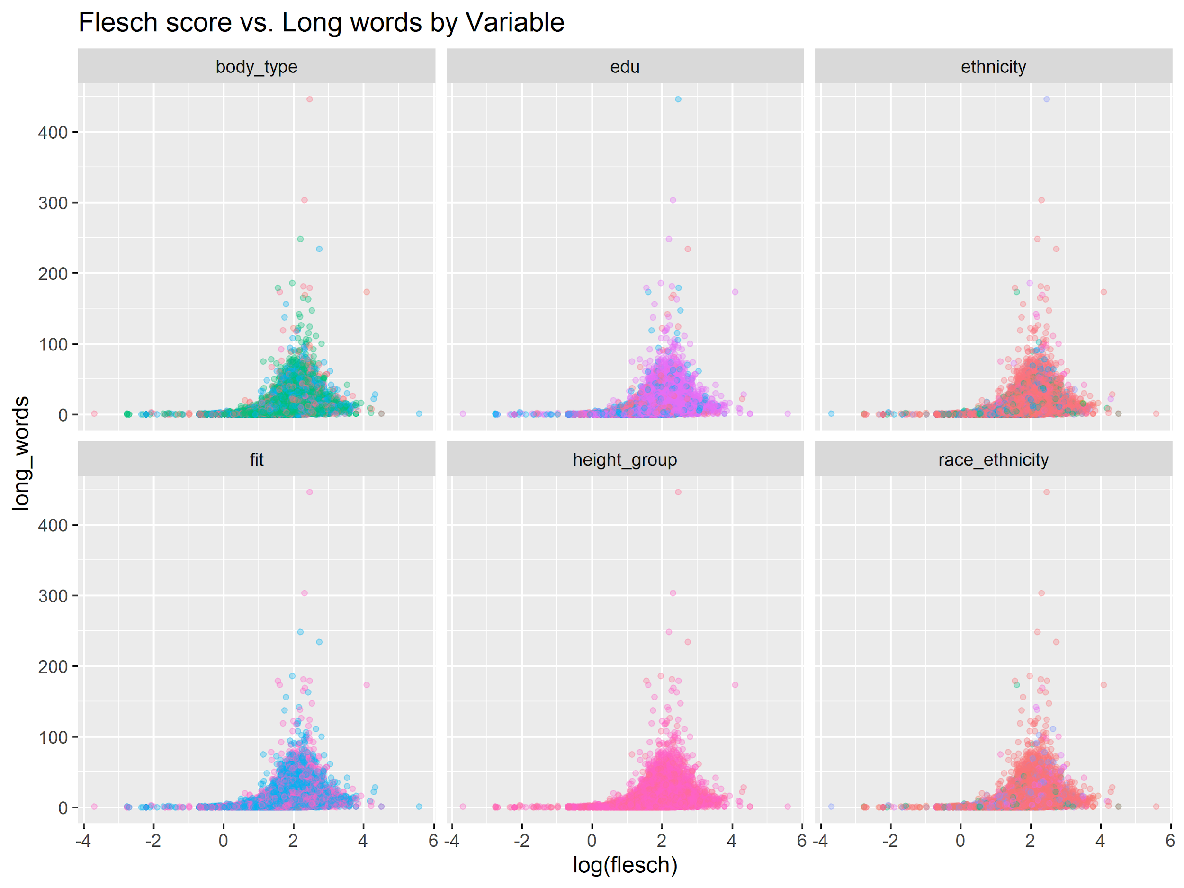
Interaction of Demographics and Text
No clear relationship between categories of demographic variables and basic quantitative measures of profile text
Notes:
Not easy to combine in the traditional manner

Slide 12
Core Hypotheses and Assumptions
Demographics CAUSE text patterns
Norm Exists | Demographics
Deviations from norm -> More memorable -> More matches
Reference: Parmentier (1994)
Notes:
Demographic variables either cause or are correlated with variables that cause users to choose a certain approach to self-representation and marketing
There exists a culturally accepted ‘norm’ (or to quote Peirce from anthropology, a ‘legisign’) of what kind of information SHOULD go into a profile.
Deviations from the norm are likely to make someone more memorable
More memorable people are likely to be ‘swiped right’/ matched

Slide 13
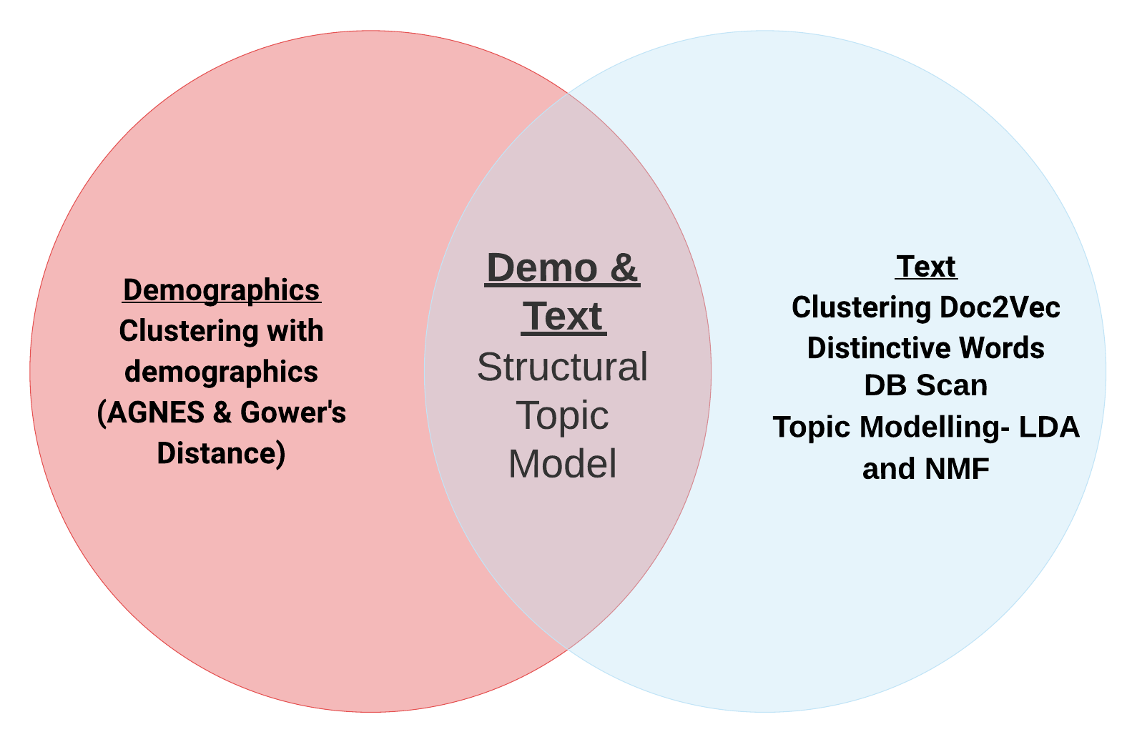
Exploring Unsupervised ML Methods
Clustering with demographics

Slide 14
Aspects of Variables
Demographics
Text
Education
Race-ethnicity
Height
Fitness Level
Difficulty Level- Sentence Complexity
Length
Proportion of Difficult Words (multi-syllable)
Topics and Topic Distribution
Humour
Low Frequency Words Used

Slide 15


Common Vs Uncommon Words
Oooh Frida Kahlo!? That sounds exciting. I’ll check him out
Affecting Ramsay crunches affiliated
Raspberry plantwhisperer FridaKahlo
Ramennoodle conjugate
The string ‘Frida Kahlo’ is an outlier. Does not affect the model. Delete. Stay single forever hahaha
Notes:
Could dig further using Part of Speech (POS) Tagging with NLTK and look into patterns of uncommon words based on demographics

Slide 16
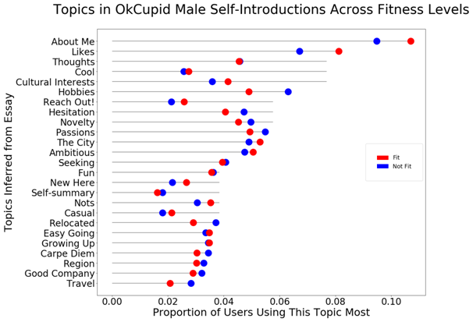
Choice of Number of Topics- I
The Old Model
Shishido et al (2016) used Negative Matrix Factorization
Pros- Clearer Topic Separation for short texts
Cons- Not amenable to Structural Topic Modelling

Slide 17
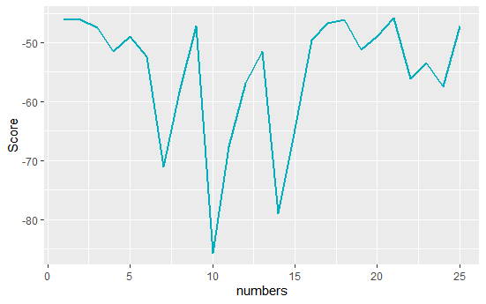
Choice of Number of Topics II
LDA Model
Perplexity - model's "surprise" at the data
With 9 topics: 3261
With 25 topics: 3265
(Smaller values are better)
Choose the topics based on semantic coherence scores

Slide 18
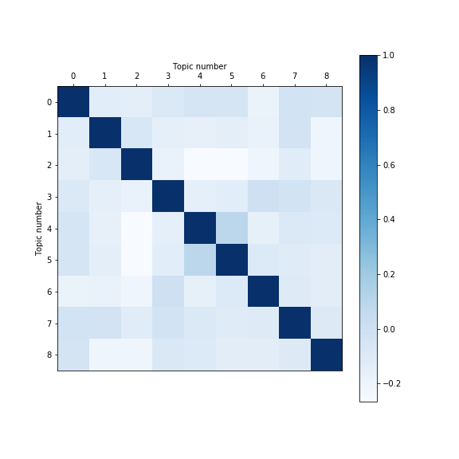
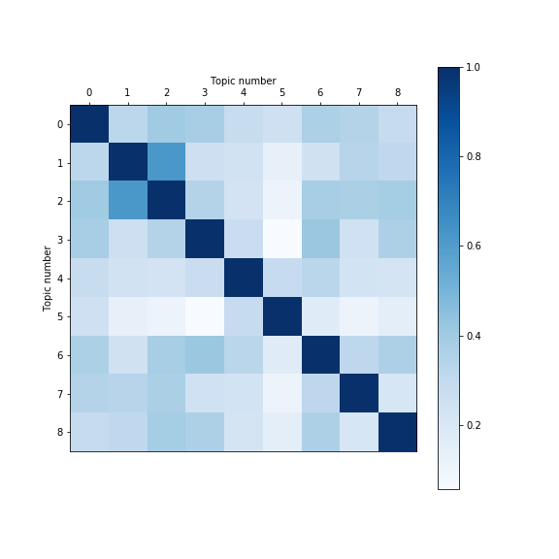
Topic Co-Occurrence vs Correlation

Slide 19
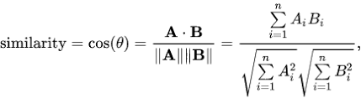
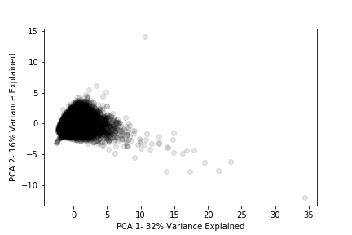
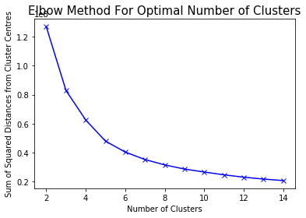
Doc2Vec

Slide 20
How this Helps
App Recommendation:
Using Doc2Vec
“ Li, you sound similar to 48% users with Ethnicity ‘Asian’ and Education ‘Masters Degree’”
Using Topic Proportions
Try talking less about Your City Background and more About Your Hobbies.
Using Unusual Words
Li, you talked about “running”. How about use ‘endurance”- that’s a rare word!

Slide 21
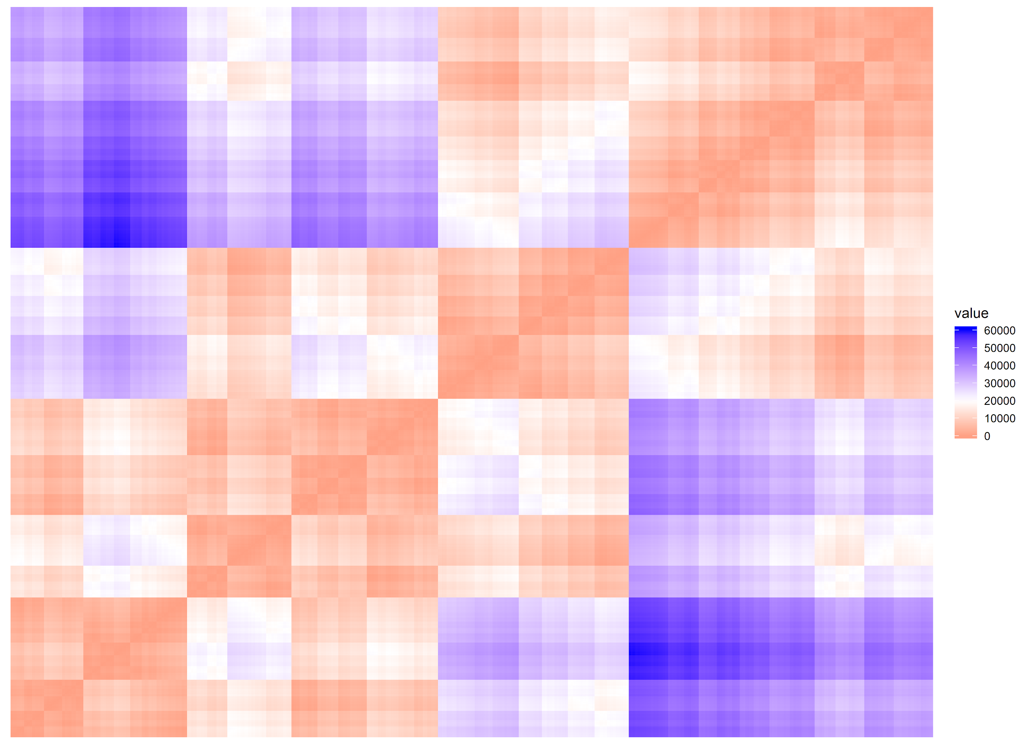
Agglomerative Nesting of Demographic Data
Demographic data from a random subset of 2,000 profiles
Hopkins Statistic of 0.770
Using a Gower’s dissimilarity matrix and Ward.D2
Three clusters selected using Nbclust

Slide 22
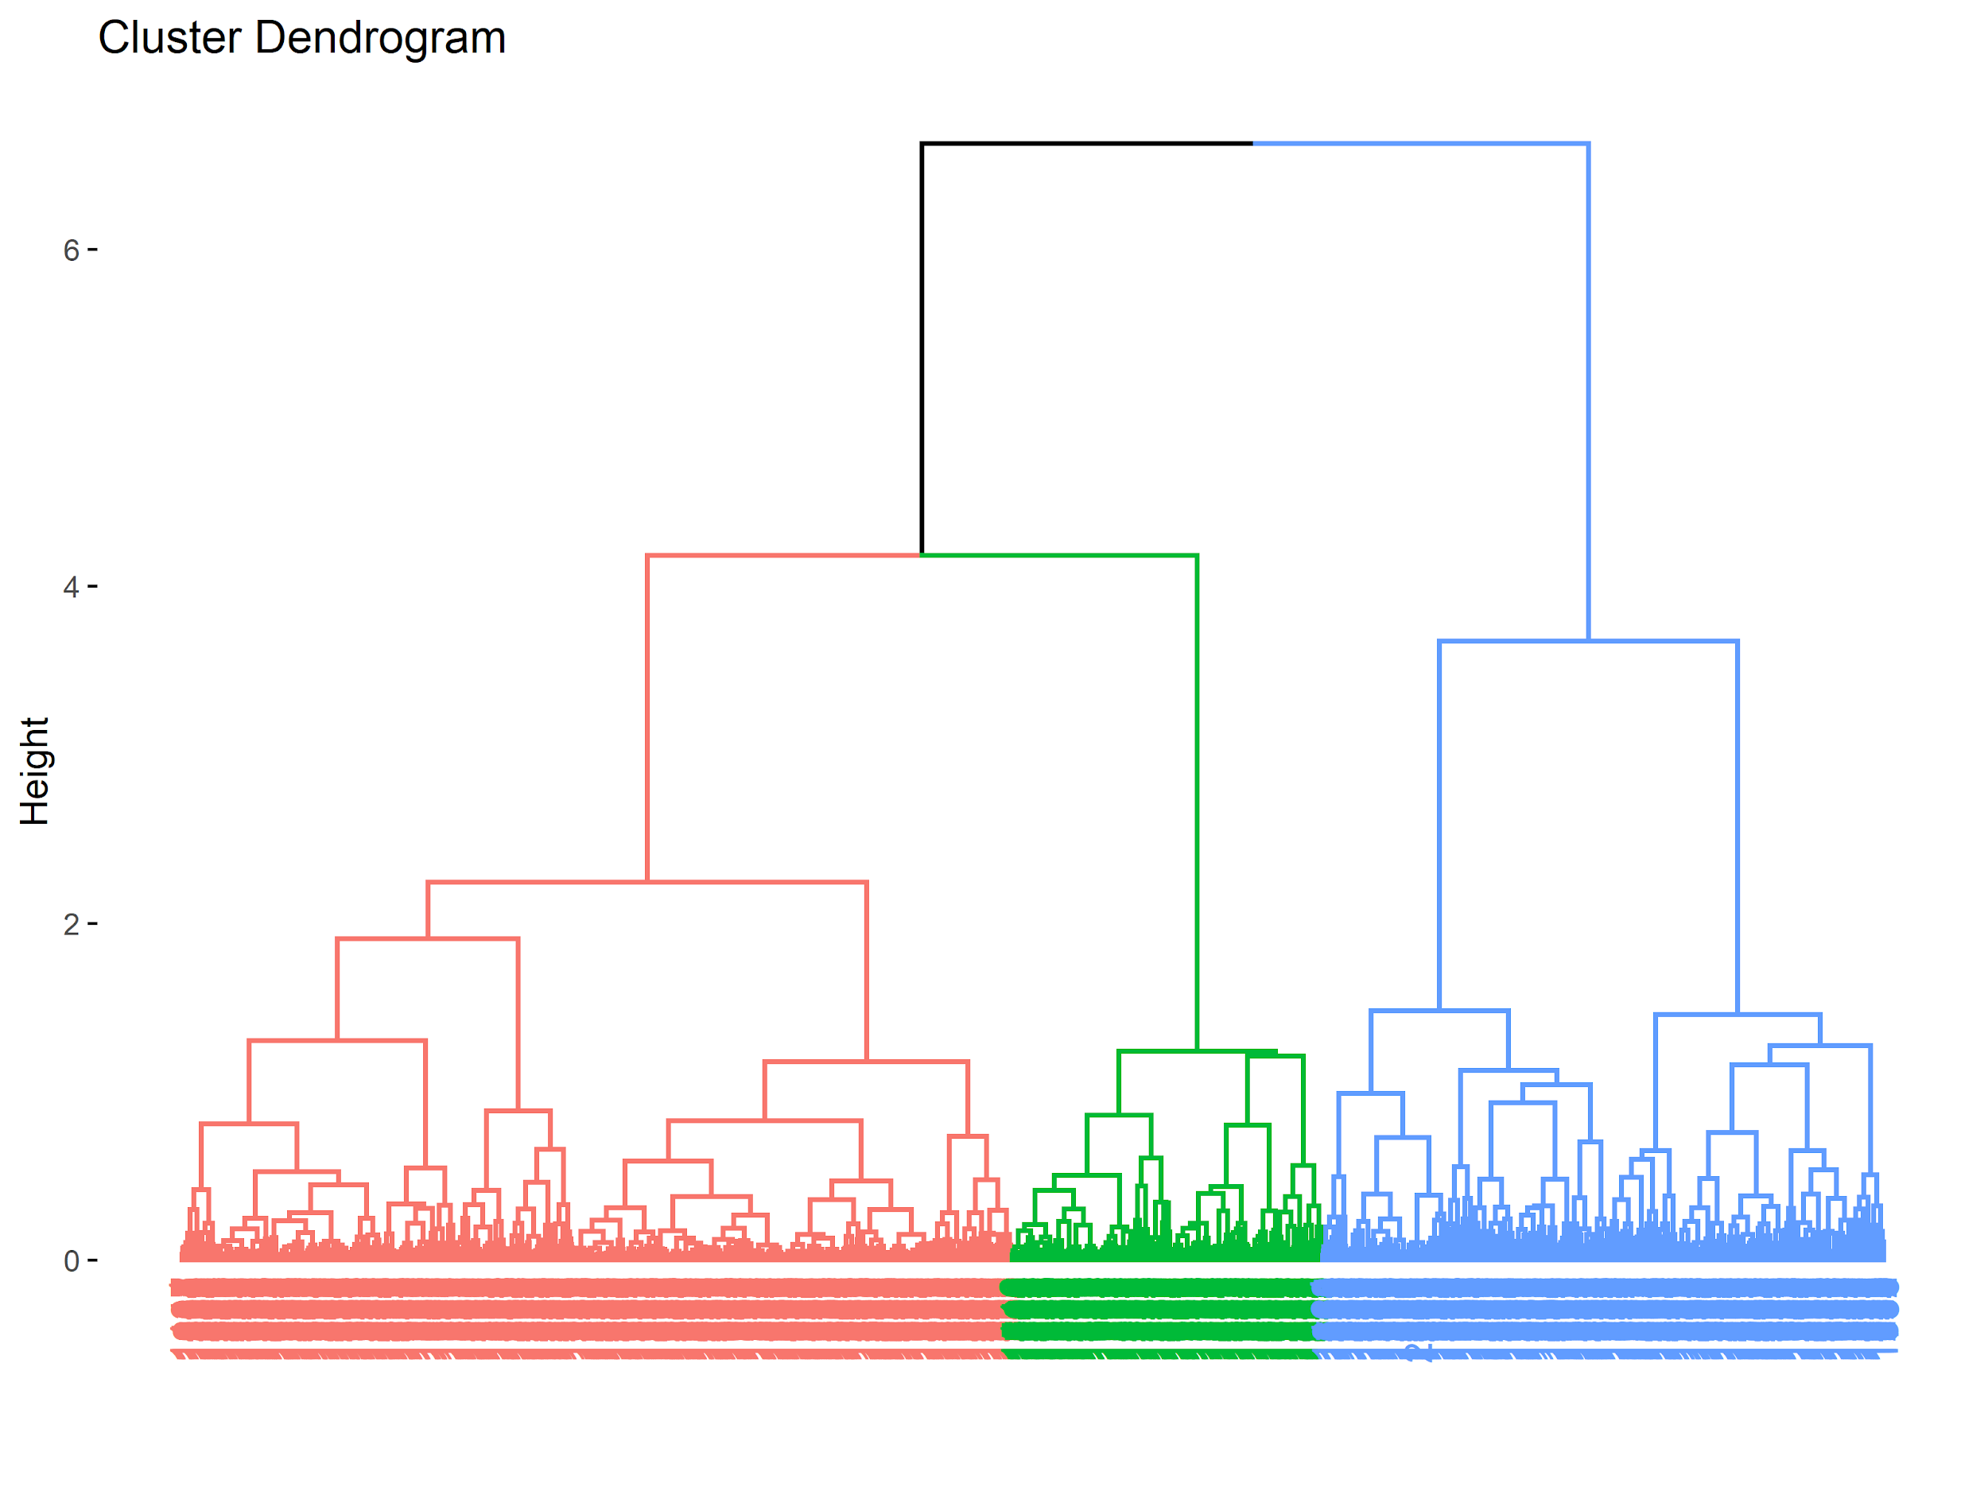
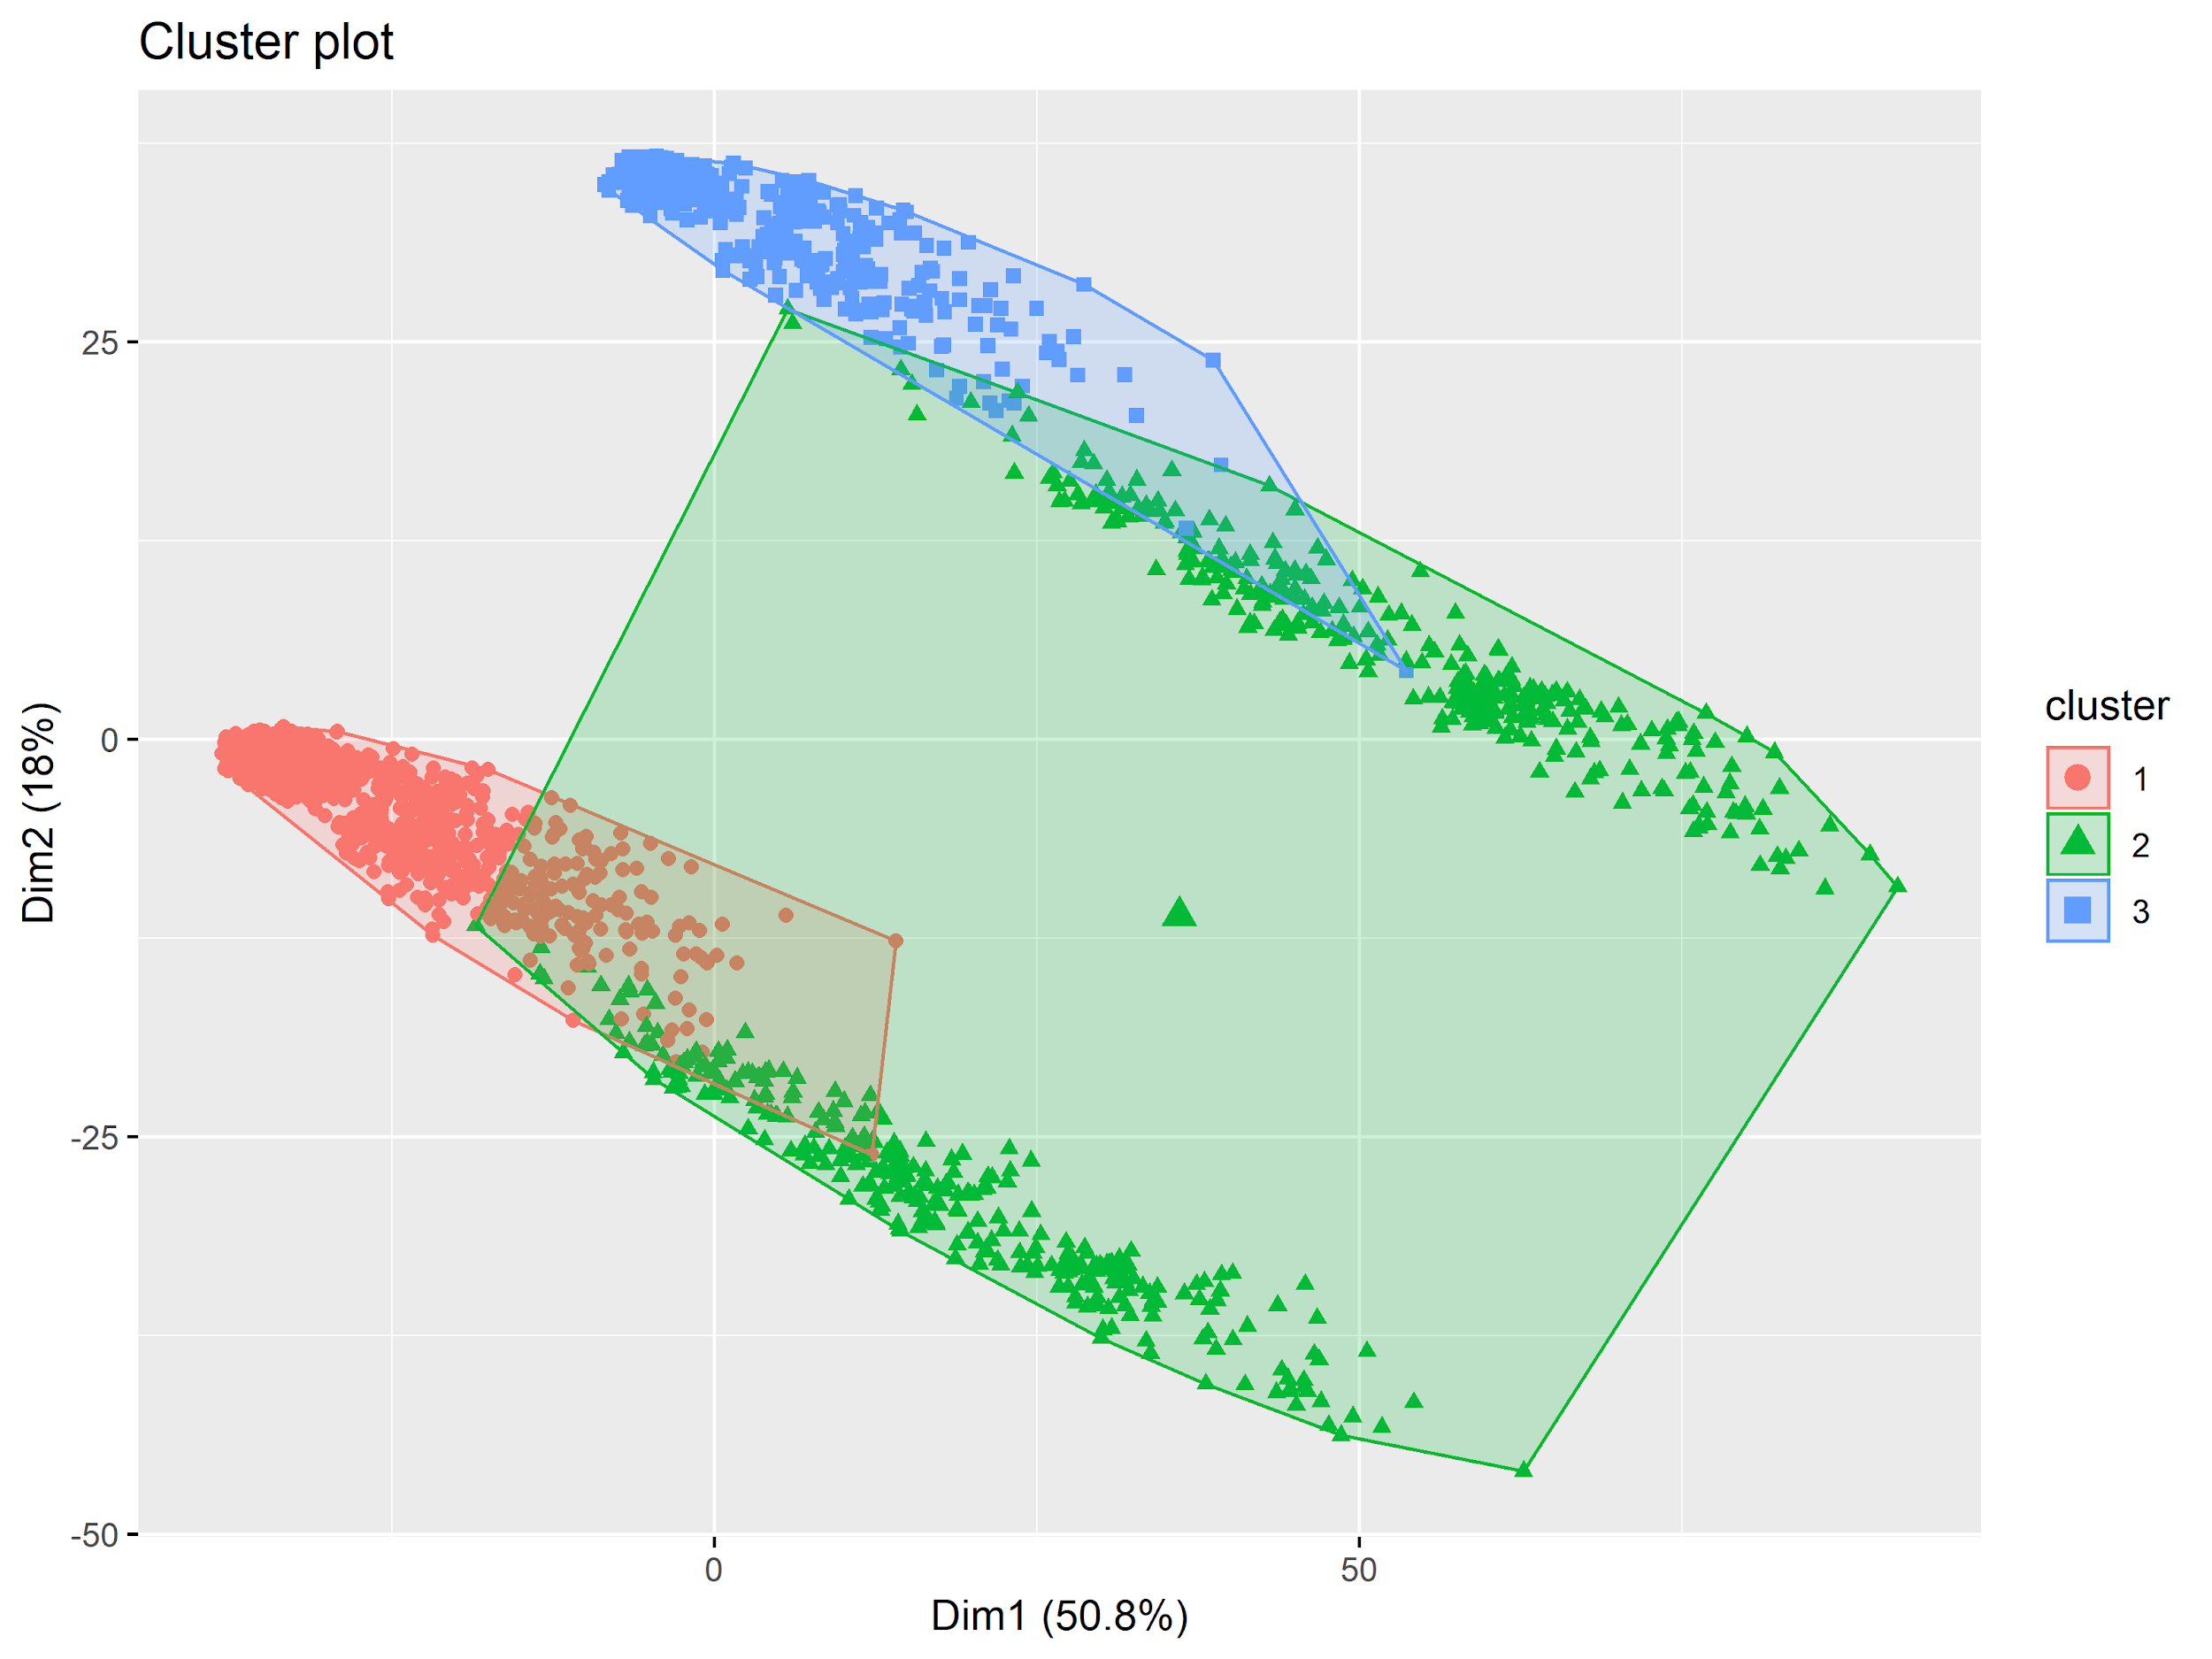
Agglomerative Nesting of Demographic Data

Slide 23
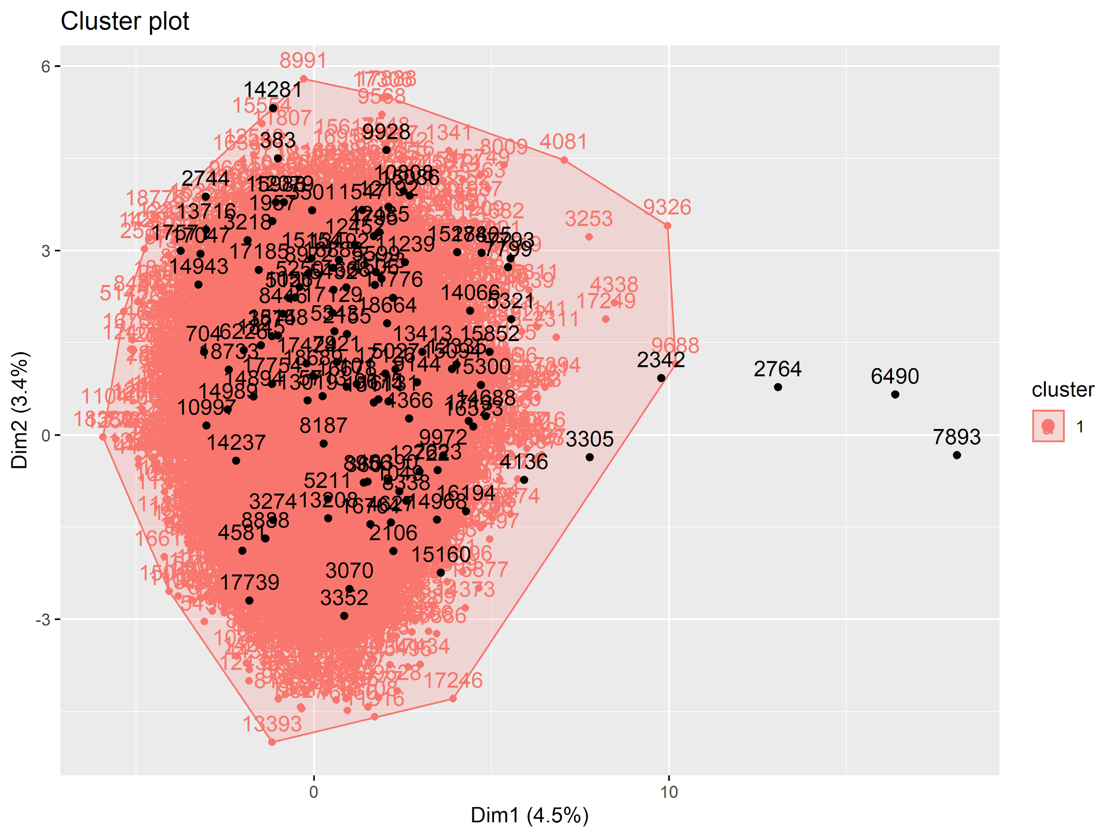
Identification of Doc2Vec Outliers with DBSCAN
Uses 50 vectors from Doc2Vec, amount of long words, and Flesch scores generated from profiles
Hopkins Statistic of 0.808
Epsilon neighborhood size of 9 selected from a 5-NN distribution plot

Slide 24
Identification of Doc2Vec Outliers with DBSCAN
Typical Profiles
“i’ve lived in san francisco for almost 5 years after moving herefrom the uk. i’m laid back and don’t sweat the small stuff…”
“i’m a playful red-haired guy who’s both shy and outgoing. who likesto play around and be serious...”
Outlier Profiles
“i’m a super-cerebral dude. i’m prone to pontificate my thoughtsaloud to my empty apartment…”
“employed full time with benefits. don’t pay child support. nokids.never married. no alimony. no pending law suits. not crazy…”

Slide 25
How this Helps
App Recommendation:
Using DBScan
“Li, you talked about your interests in a way that matches most 78% users in your demographic.
How about you use your ‘running’ and ‘China’ keywords to become more funny?”

Slide 26
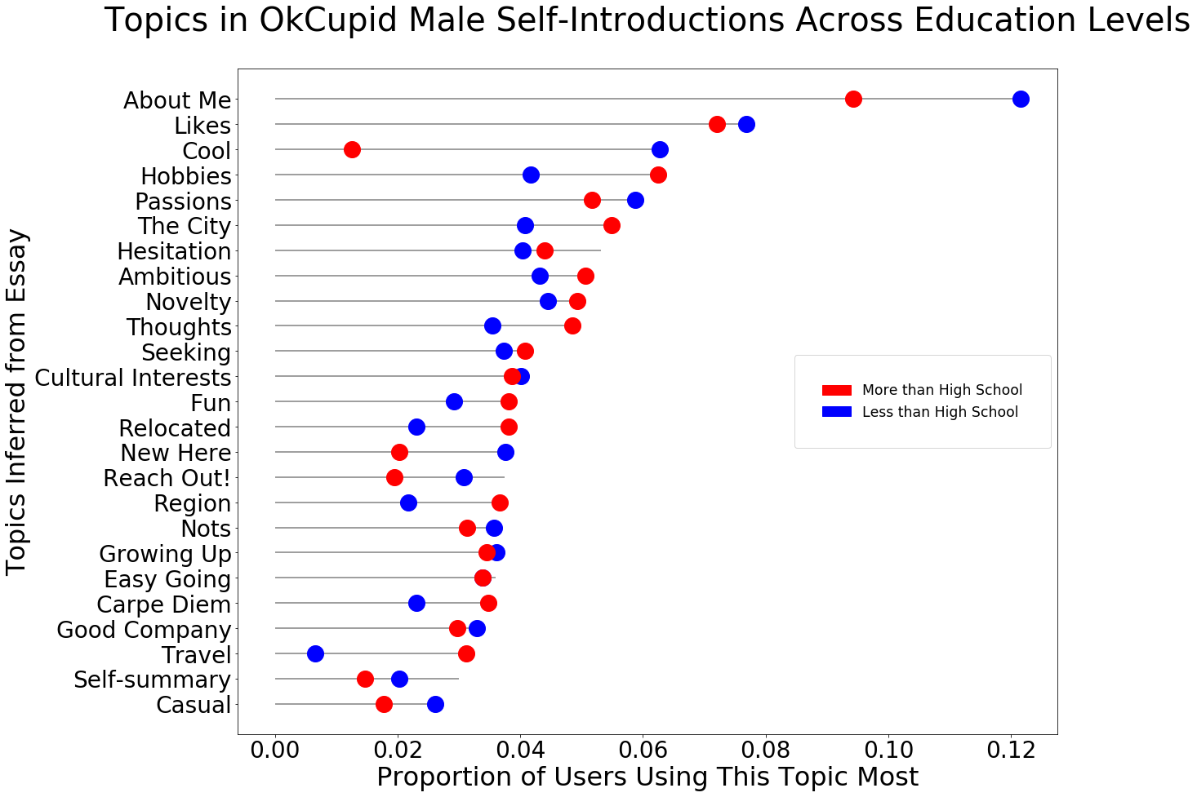
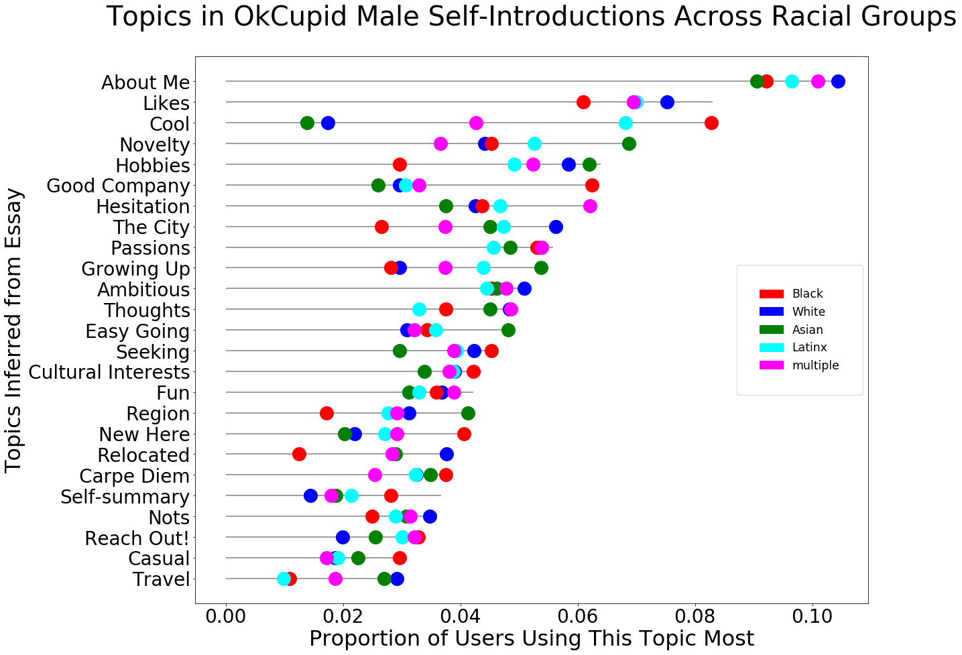
Linking Topic Model and Demographic Variables
Approach 1. Topics comparisons for different factors
Issue: Hard to test if variations are by chance or true underlying differences in subpopulations

Slide 27
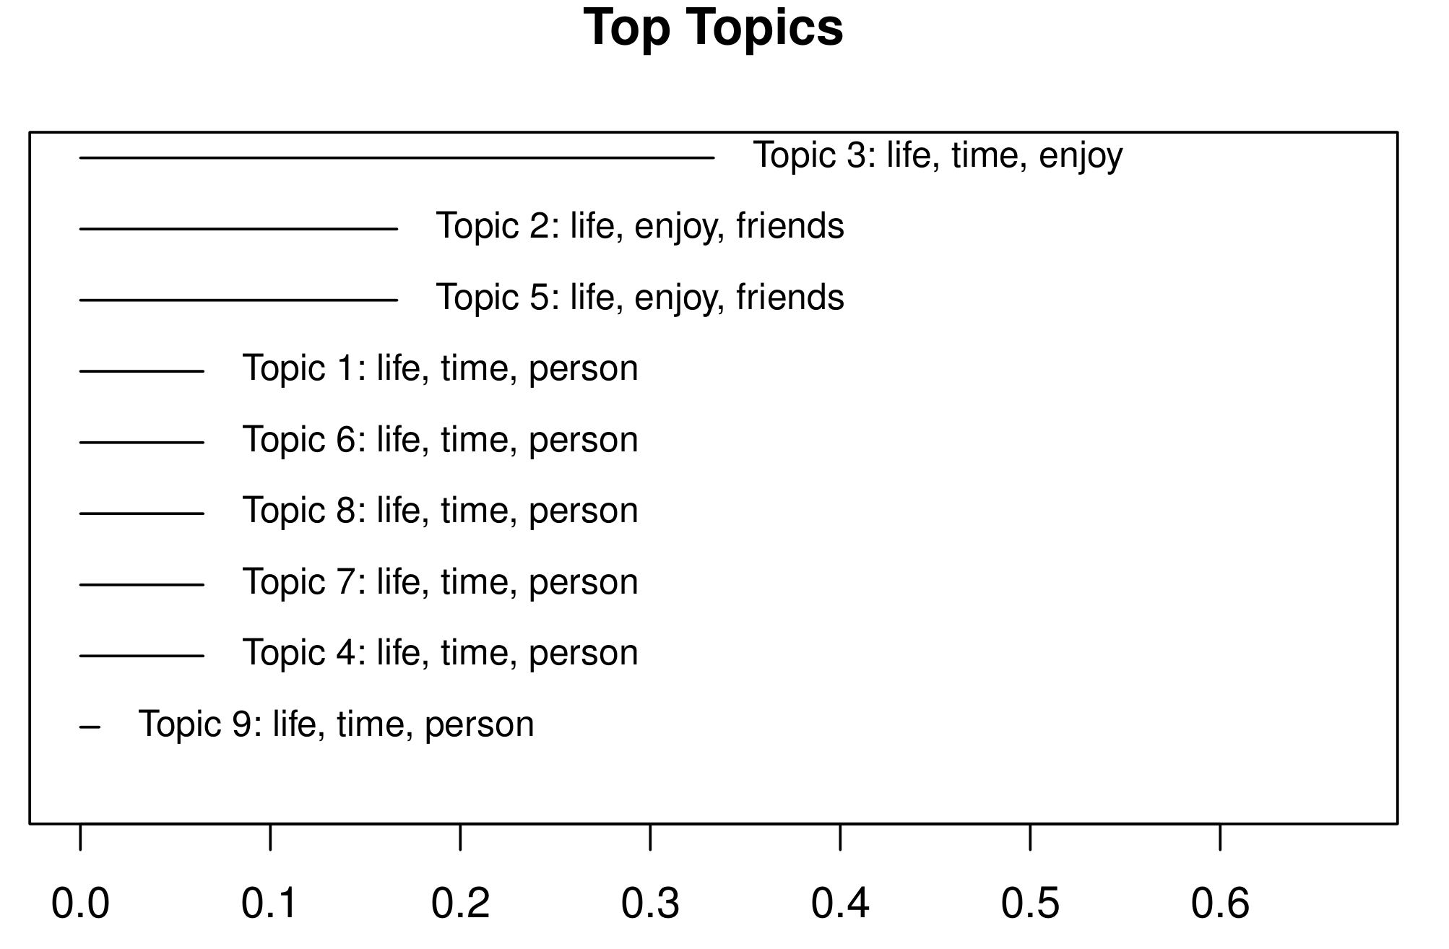
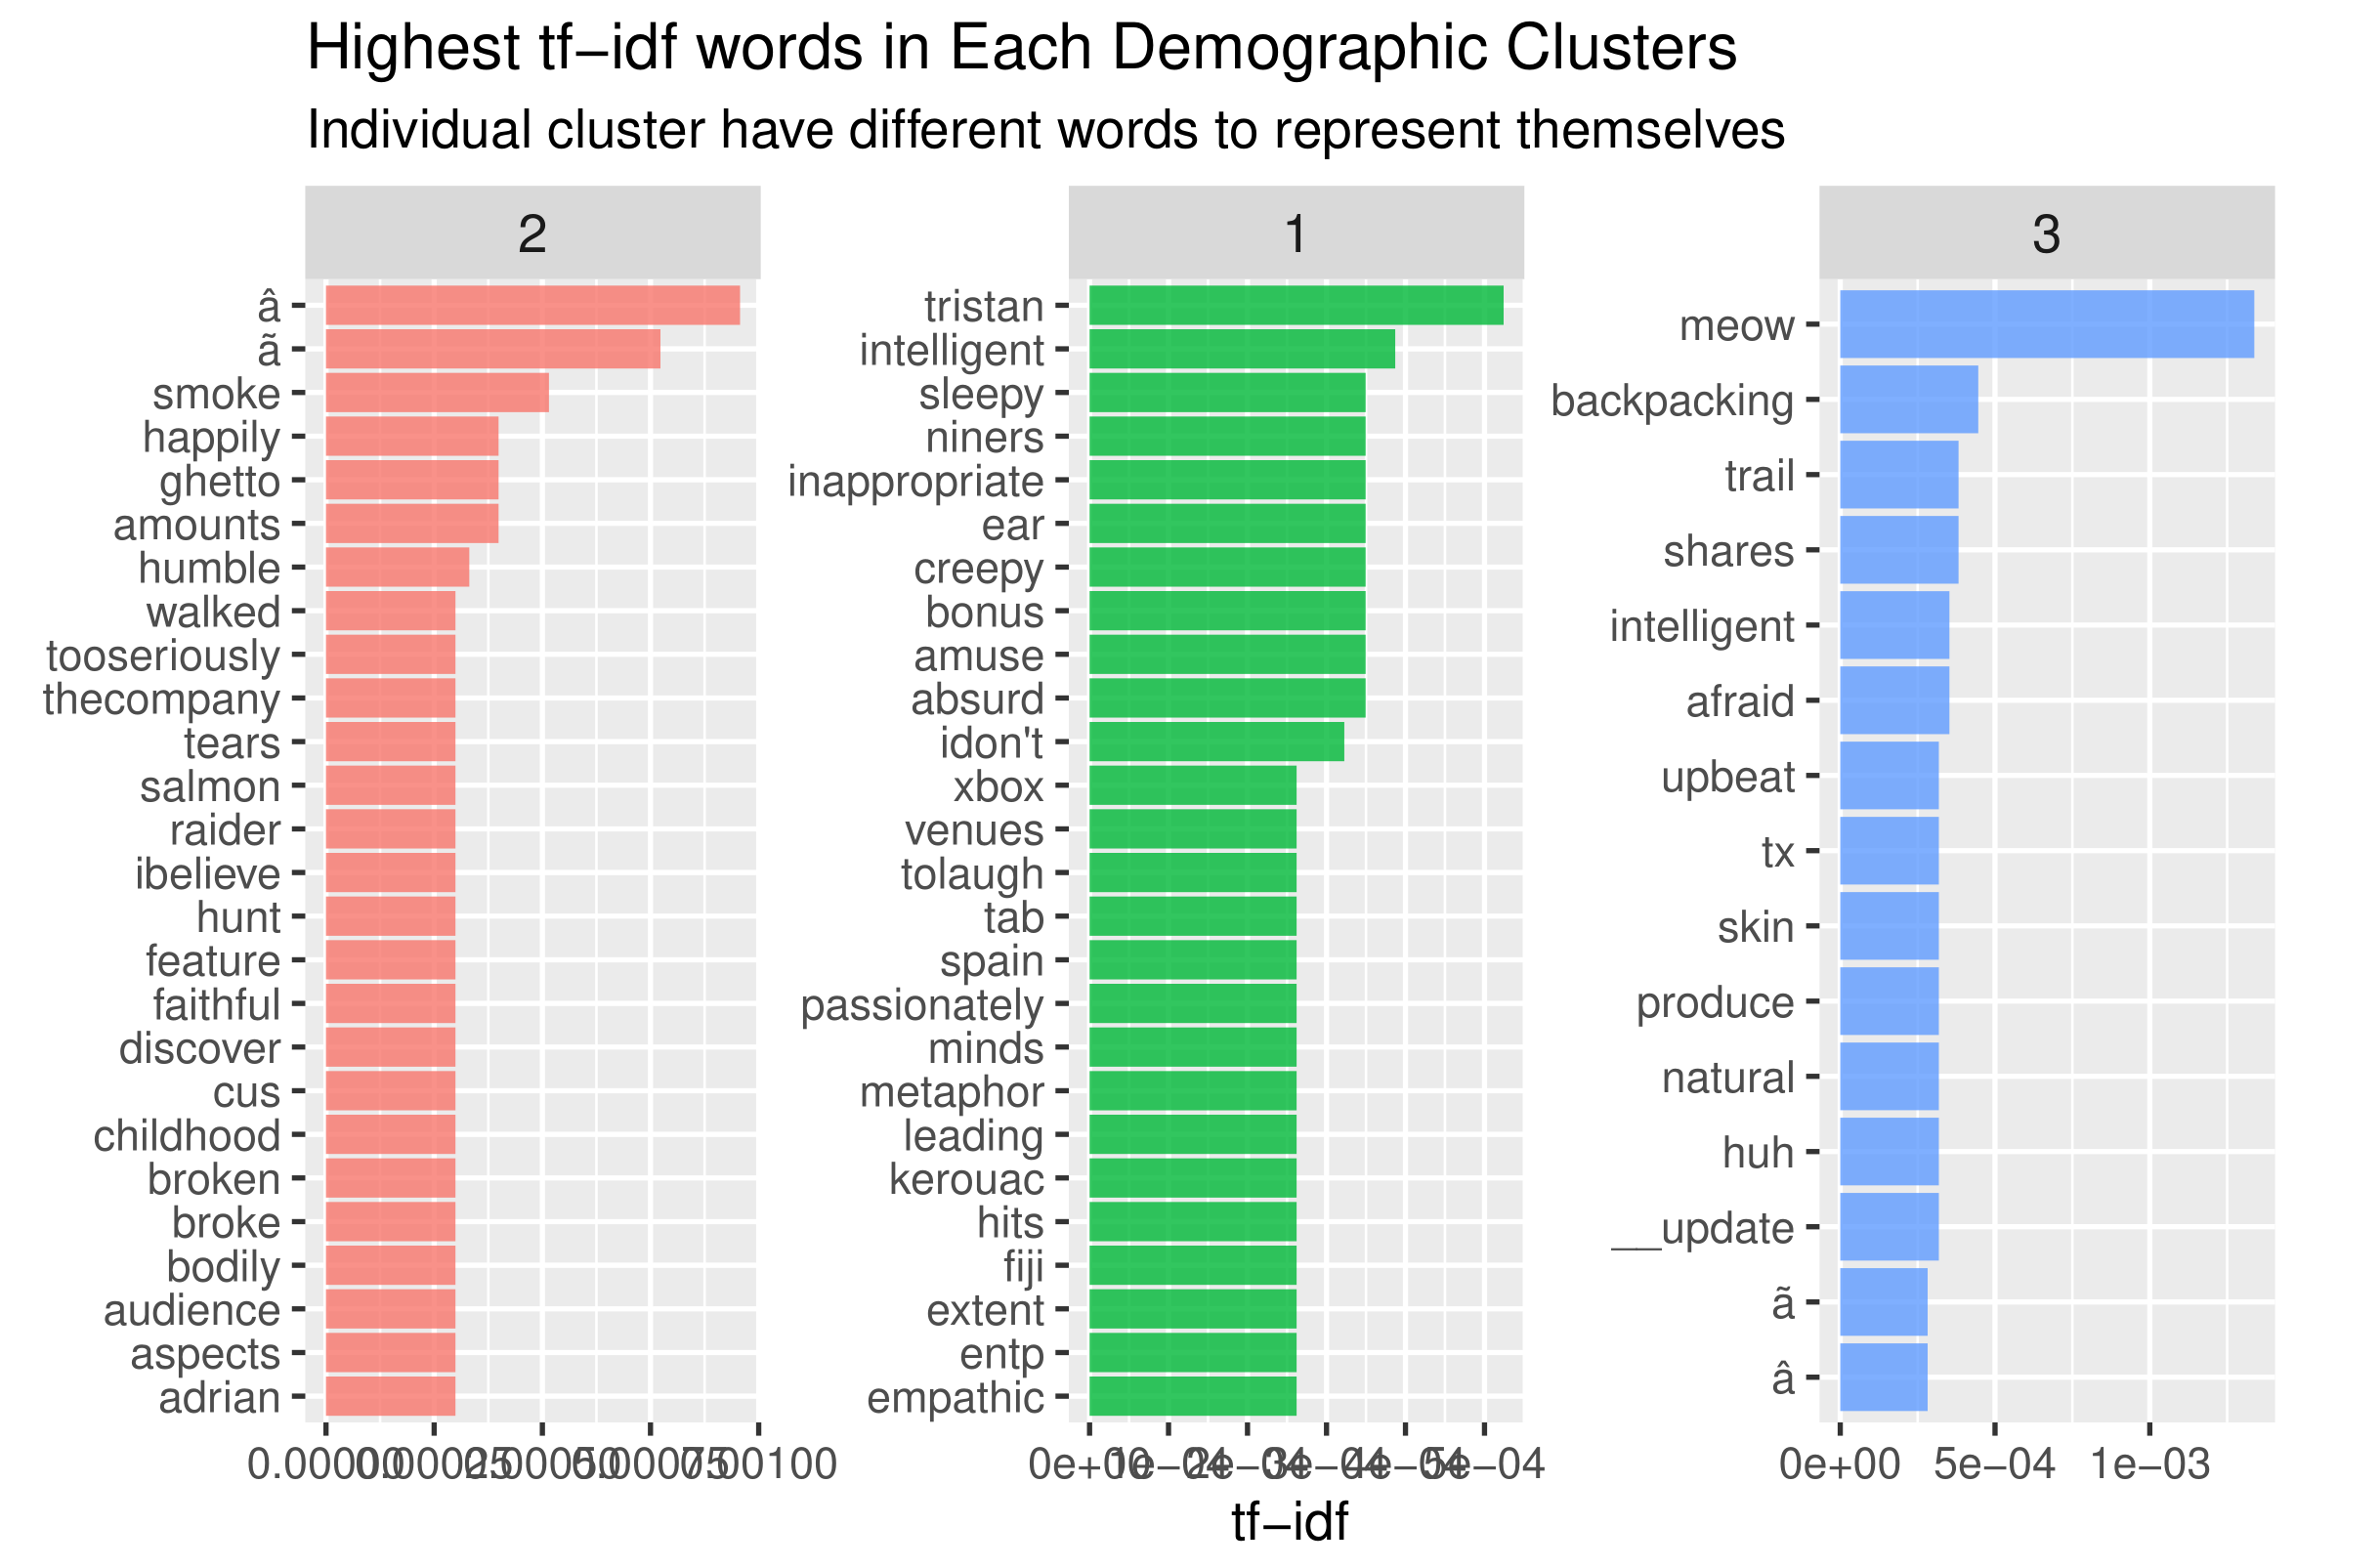
Linking Topic Model and Demographic Variables
Approach 2: Topic Modeling for Clusters
Issue: a. No clear differences; b. Cluster outcomes vary depending on the variables and methods; Clusters are not quite heterogeneous

Slide 28
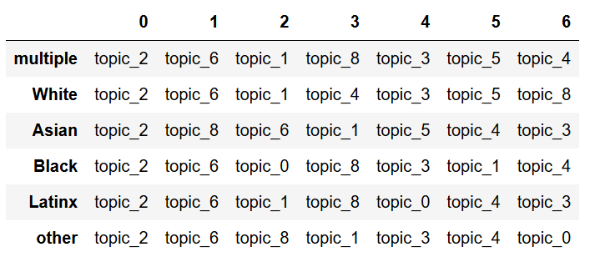
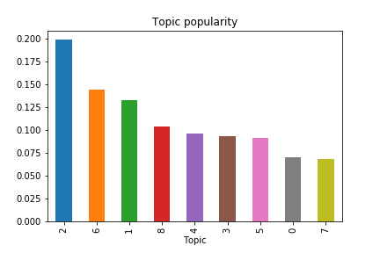
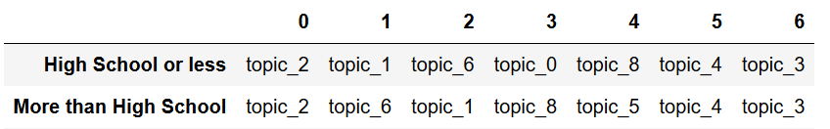
Assumption: Common Rankings
Top 7 By Race
Across All Demographics:
Top 7 By Education
Notes:
Topic 2 is identical. Second highest proportions are 6 or 8.
Against the hypothesis (everyone has the same ranking)
We use the deviations. How do we know they are not by chance?

Slide 29
Structural Topic Model
Purpose: Estimating metadata and topic relationships
Difference: LDA assumes topics are latent;
STM uncover the "true" structure of the document configurations
Dependent variable: proportion of each document about a topic (“prevalence”)
Independent variables (Metadata/Covariates):
User Demographics (fit + edu + height_group + race_ethnicity)
DBScan Cluster
Regression: Predict how prevalence shift as a function of the covariates

Slide 30
Significant Covariates of STM
(0: '***' 0.001: '**' 0.01: '*' 0.05 : ‘.’')
Topic / X | fit_not_fit | fit_unknown | edu_More than High School | edu_unknown | height_groupshort | race_ethnicityBlack | race_ethnicityLatinx | race_ethnicitymultiple | race_ethnicityother | race_ethnicityWhite | dbscan_cluster
1 |  |  | ** | ** | . | ** | ** | *** | *** | *** | ***
2 |  | * | *** |  | * | * |  | * |  | *** | ***
3 | *** | * | *** | *** | ** | * |  | * | ** | ** | *
4 | *** |  | *** |  | *** |  |  | *** |  | *** | ***
5 |  |  | *** | ** | *** | *** | * | ** |  |  | ***
6 | ** | * | *** | *** |  | *** | *** | ** | *** | *** | **
7 | ** | *. |  |  |  | . |  |  |  | ** | **
8 | *** | . |  | ** |  | ** | . | *** | *** | *** | ***
9 | *** | *** | ** | ** |  | * | *** | *** | *** | *** | ***

Slide 31
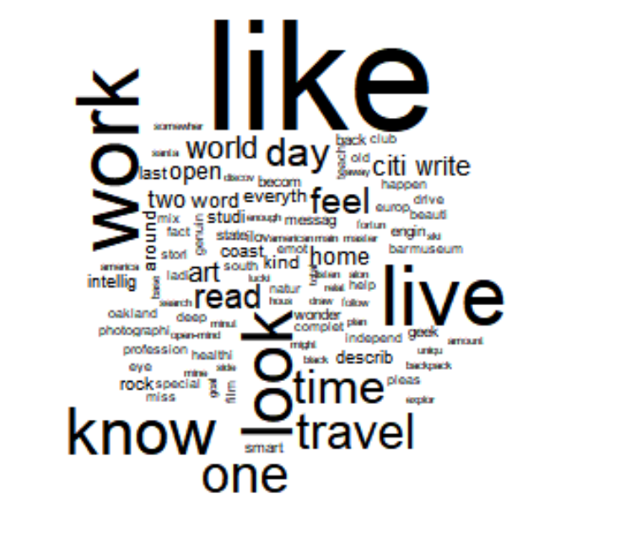
Significant Covariates
(0: '***' 0.001: '**' 0.01: '*' 0.05 : ‘.’')
Topic / X | fit_not_fit | fit_unknown | edu_More than High School | edu_unknown | height_groupshort | race_ethnicityBlack | race_ethnicityLatinx | race_ethnicitymultiple | race_ethnicityother | race_ethnicityWhite | dbscan_cluster
1 |  |  | * |  |  |  |  | *** | ** | ** | ***
2 | *** |  | *** | ** |  |  | ** | * |  | **
3 | *** | * | *** | *** |  |  |  | **
4 | . |  | *** | * |  |  |  | * |  | *** | **
5 | . |  | * |  |  | **
6 |  |  | ***
7 |  | . | . |  | . | . |  |  | * |  | **
8 | *** |  | ** | *** |  | *** | *** | *** |  | *** | *
9 | *** |  | *** |  |  | *** |  |  |  |  | **
Topic 6 might be “hard working”
Only more_than_high_school factor changes the proportion of Topic 6

Slide 32
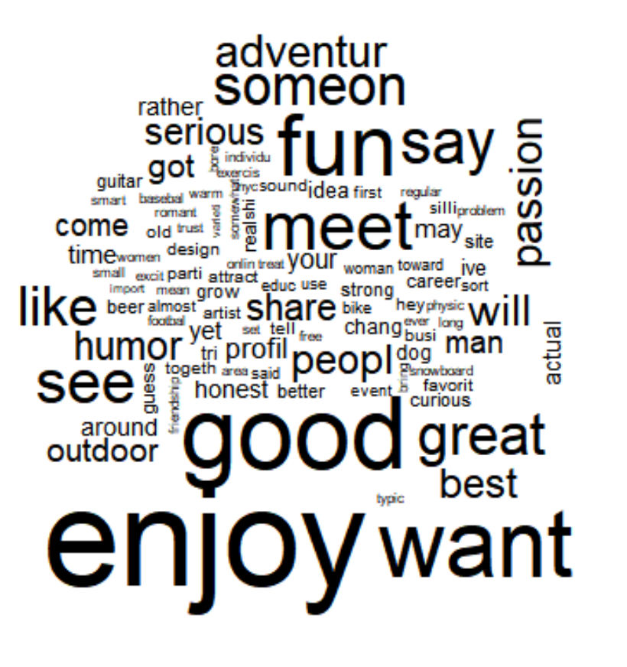
Significant Covariates
(0: '***' 0.001: '**' 0.01: '*' 0.05 : ‘.’')
Topic / X | fit_not_fit | fit_unknown | edu_More than High School | edu_unknown | height_groupshort | race_ethnicityBlack | race_ethnicityLatinx | race_ethnicitymultiple | race_ethnicityother | race_ethnicityWhite | dbscan_cluster
1 |  |  | * |  |  |  |  | *** | ** | ** | ***
2 | *** |  | *** | ** |  |  | ** | * |  | **
3 | *** | * | *** | *** |  |  |  | **
4 | . |  | *** | * |  |  |  | * |  | *** | **
5 | . |  | * |  |  | **
6 |  |  | ***
7 |  | . | . |  | . | . |  |  | * |  | **
8 | *** |  | ** | *** |  | *** | *** | *** |  | *** | *
9 | *** |  | *** |  |  | *** |  |  |  |  | **
Topic 8 is “enjoy good life”
People with different demographics say differently about enjoying lives

Slide 33
Closing Notes
By Final Project:
Validation of STM results
Testing for Differences in Number of Topics at Level of Individual Profiles
Test model using AGNES clusters and varying topic number accordingly
For Future Research:
Factor Modelling
Association Rules Mining
Notes:
The variables driving choice of words- such as cognitive skills, cultural attitudes, personality traits are likely to be latent (and unobservable) factors. A factor analysis may be useful for future analysis
We can test the impact of

Slide 34
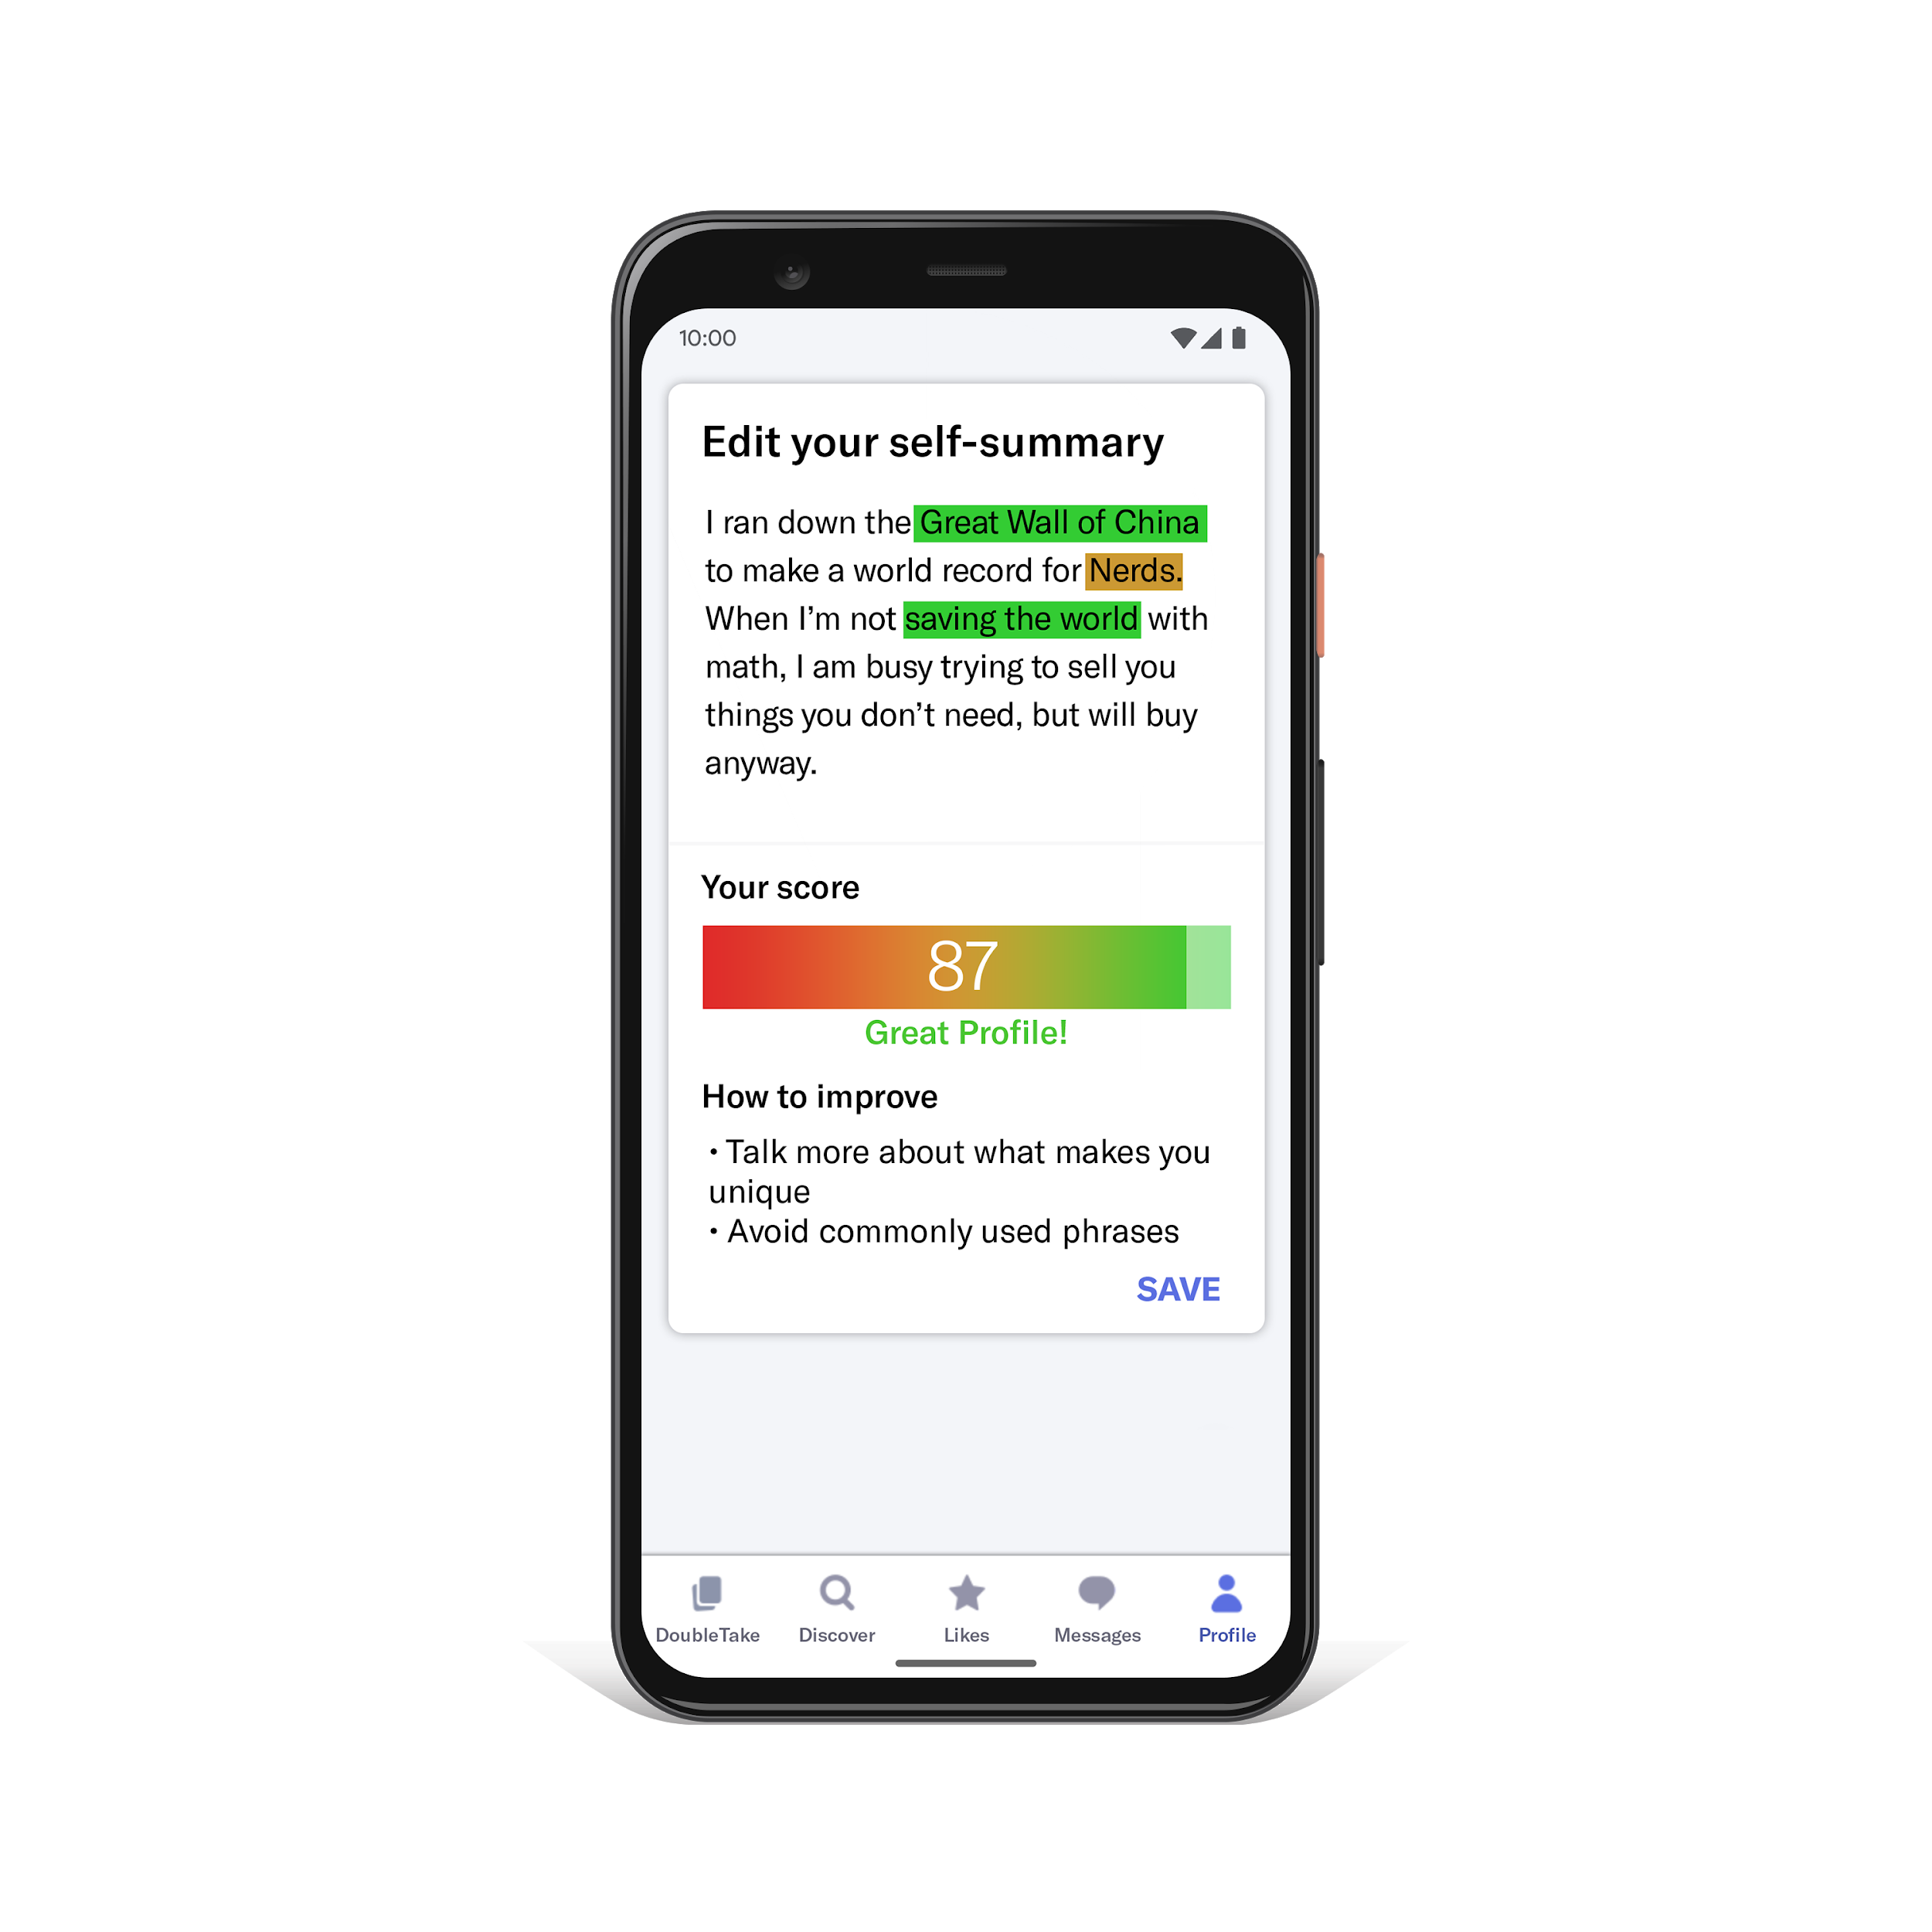
One More Thing...

Slide 35
Appendix
Slides
Type Right =
Swiped Right

Slide 36
References
Burke, R. Social News Daily. ‘Snapchat’s Gender Switch Filter Shows Men What Online Dating Is Like For Women’, Retrieved from: https://socialnewsdaily.com/86938/snapchats-gender-switch-filter-shows-men-what-online-dating-is-like-for-women/
Fiore, A. T., Taylor, L. S., Mendelsohn, G. A., & Hearst, M. (2008, April). Assessing attractiveness in online dating profiles. In Proceedings of the SIGCHI conference on human factors in computing systems (pp. 797-806). ACM.
Fiore, A. T., Taylor, L. S., Zhong, X., Mendelsohn, G. A., & Cheshire, C. (2010, January). Who's right and who writes: People, profiles, contacts, and replies in online dating. In 2010 43rd Hawaii International Conference on System Sciences (pp. 1-10). IEEE.
Emory, Leah(2017), Bustle. ‘How Many People Who Meet On Dating Apps Get Married? Swiping Isn't Just For Hookups’, Retrieved from - https://www.bustle.com/p/how-many-people-who-meet-on-dating-apps-get-married-swiping-isnt-just-for-hookups-44359
Stevens, G., Owens, D., & Schaefer, E. C. (1990). Education and attractiveness in marriage choices. Social Psychology Quarterly, 62-70.
Shepperd, J. A., & Strathman, A. J. (1989). Attractiveness and height: The role of stature in dating preference, frequency of dating, and perceptions of attractiveness. Personality and Social Psychology Bulletin, 15(4), 617-627.
Shishido, Juan, Jaya Narasimhan, and Matar Haller. "Tell Me Something I Don’t Know: Analyzing OkCupid Profiles." (2016).
Torpey, Elka, 2018 , ‘Measuring the value of education’, Bureau of Labour Statistics. Retrieved from:
https://www.bls.gov/careeroutlook/2018/data-on-display/education-pays.htm

Slide 37
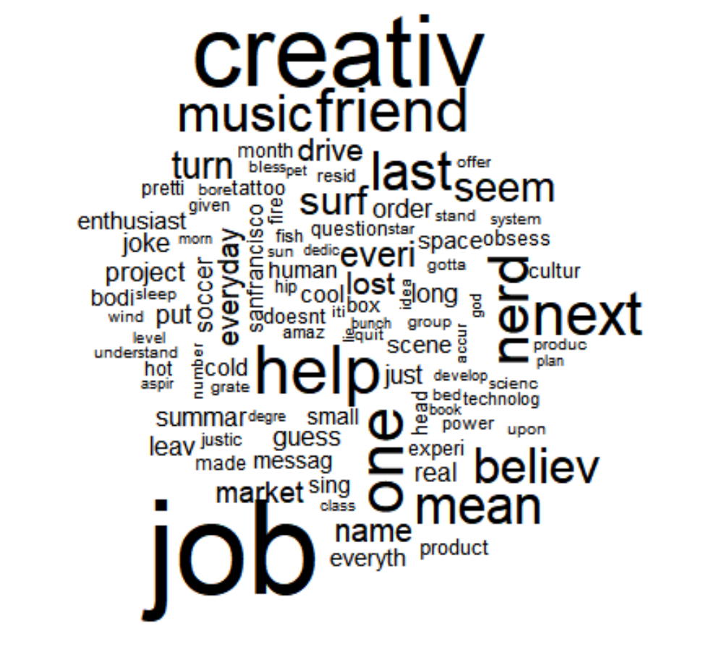
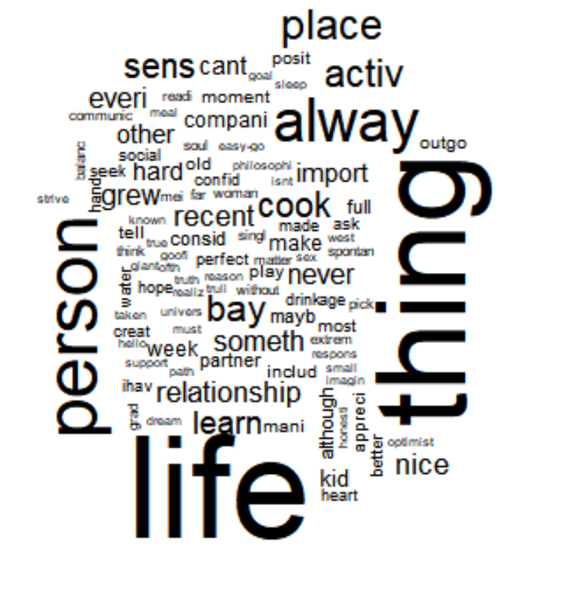
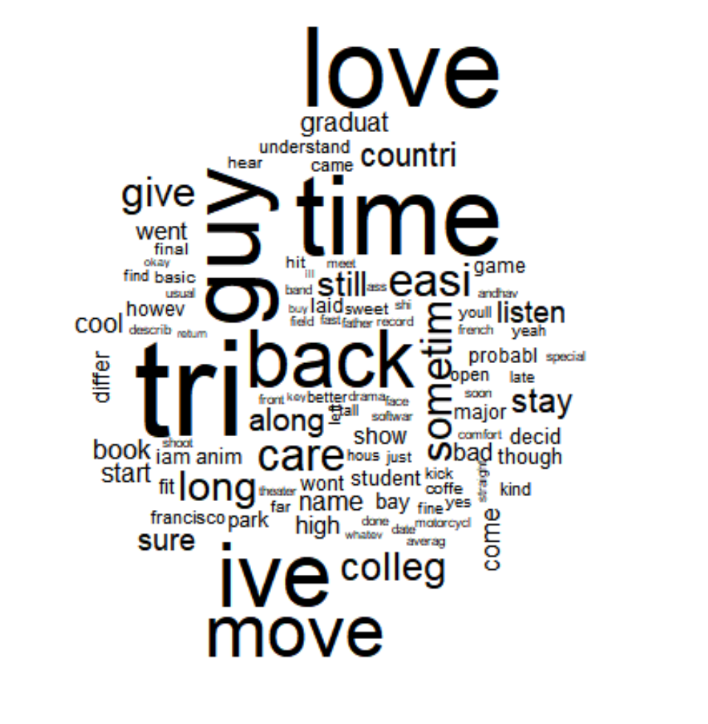
Word Cloud
Topic 1
Topic 2
Topic 3

Slide 38
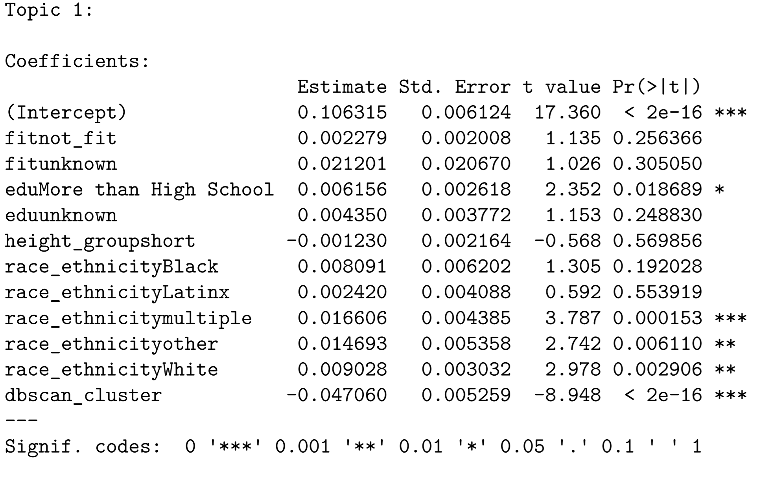
STM Effect Coefficients

Slide 39
Common Mistakes
Information Overload:
i am very skeptical of the premise of online dating i am here to shake things up i am a kind of a somebody until you get me outdoing something then i get into it and always have a good-time love to cook and bake i play the bass guitar and have been teaching myself to play bluegrass guitar though i'm still pretty terrible i love the ocean but i'm a terrible swimmer i fish i read a lot and love to sit on the beach ideally all three at once i make my own beer and am pretty sure you'll like it if you like beer i almost never drink hard alcohol i coach high school track and field jumping and hurdling in particular at the high-school i went to and love iti'm a self defined nerd who likes sci-fi and can probablytroubleshoot nearly any problem you have with your mac i'm into the environment and have a degree in conservation and resource studies i love to hike and sit in beautiful high up places i am an only child but please don't ask me if i liked it i really can't tell you what having siblings would be like so i don'tknow i was born and raised in the north bay and hope that i never have to live anywhere where it snows even for part of the year am a storehouse of useless random trivia i'm pretty sureit's taking away from important information but i can't help it i love learningi'm looking to make some new friends in the area and also to meet a nice easygoing girl who will accept my quirks hit me up if you want to do something outdoors or just want to get a coffee or a beer and chat
Not Much To Work With:
“everything simple” “kicking it”
Not Targeted:
“u like to dance or eat”
Relevant Research: Fiore et al (2010)

